Slide 1
Science Thoughts 8/21
What is the equation for speed?
S=d/t

Slide 2
Today in Class
Table of Contents
#27 – Run! Lab (3 pages)
#28 – Science Thoughts 8/21 – 8/25
#29 – Nerd Words – Describing Motion 2
#30 – Reflection 8/21 – 8/25
#31 - Frame of Reference Practice
Take Scientific Method Test
Complete #31
Complete Labs and Book work from last week

Slide 3
Science Thoughts 8/22
What is the speed of a runner on a track who runs 800 meters in 2 minutes?
S=D/T
S=800m/2min
S=400m/min

Slide 4
Today in Class
#27 Review Graphing
INB check #3
#32 Distance Time Graph
#33 A Speedy Journey
#27 Run! Lab
#34 Speed Time Graph

Slide 5
Review Graphing
Graph the growth of the seedling.
Notice
X-axis – DAY 1 through 12
Y-axis – growth 0 to 9 by ½ cm (.5,1,1.5,2,…)

Slide 6
What is Speed?
Speed is the measure of how fast something moves or the distance it moves in a given amount of time.

Slide 7
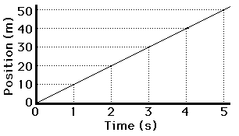
Graphing Motion

Slide 8
Now:
Complete Distance Time Graph Review
Then:
Complete A Speedy Journey
Then:
Complete Run! Lab

Slide 9
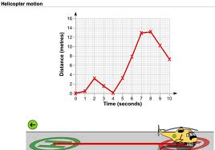
Science Thoughts 8/23
Helicopter Motion
What does this graph tell us about the motion of the helicopter? (list 3)
  Did not travel at a constant speed
  Faster between 4-7 seconds
  Went backwards between 2-4 seconds.

Slide 10
Distance Time Graph

Slide 11
Velocity Time Graph

Slide 12
In class today
https://www.youtube.com/watch?v=l93-BkAJ3UY
(4:06)
Calculating Speed Using an Equation

Slide 13
Speed

Slide 14
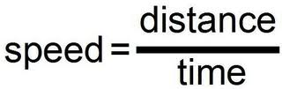
Speed is the rate of distance over a period of time.
Therefore, we can calculate speed using the formula:
S= Speed
d= Distance
t= Time

Slide 15


Measuring Motion
Speed is the distance an object travels per unit of time.
If it takes you 1 hour to drive a total of 60 miles, then how fast were you going?
  60 mph (miles per hour)
To calculate speed:
  Divide the distance by the time

Slide 16
Sample Problem #1
Maria walked 2 km in half an hour. What was her speed during her walk?

Slide 17
Sample Problem #1
Formula-
Substitute-
Speed = ? We will use variable S
Distance= 2 km Time= 0.5 hour
Solve-
S = 2km/ 0.5 hour
Answer- D= 4 km/hour

Slide 18
Sample Problem #2
A wheelchair racer completes a 100- meter course in 20 seconds. What is his speed?

Slide 19
Sample Problem #2
Formula-
Substitute-
Speed = ? We will use variable S
Distance= 100 meters Time= 20 seconds
Solve-
S = 100 m/20 sec
Answer-
S = 5 m/sec

Slide 20
Calculating Speed
Sample Problem
Steve swims 20 m in 10 s. What is his average speed?
m=meters s=seconds
What do you know? distance= 20 m, time= 10 s
What do you want to find out? Speed
Write the formula S=d/t
Substitute into the formula S=20m/10s
Calculate and simplify S=2m/s
Check that your units agree Unit is m/s
Unit of speed is m/s. Units agree
Answer: Speed=2m/s
Your Turn:
Joe drives 120 miles in 2 hours. What is his average speed?
Show your work includes:
Writing out the formula, substitution, THEN calculate and simplify
ALWAYS Show your work, even if you can do it in your head…Always show your UNITS

Slide 21
Sample Problems
Directions: Solve the following speed problems. Use the triangle to help solve the problems. Show all your work. Circle your answer.
D
T
S

Slide 22
Science Thoughts 8/24
1. Find the speed of a long-distance runner who runs 30 miles in 6 hours.
2. A train travels at 60km/h for 20 hours. Find its distance.

Slide 23
Sample Problems
Directions: Solve the following speed problems. Use the triangle to help solve the problems. Show all your work. Circle your answer.
D
T
S

Slide 24

3. The speed of a runner is 10 m/s, over a distance of 1000m. What is his time?
4. What is the speed of a jet airplane flying from St. Louis, Missouri, to Phoenix, Arizona, in 3 hours. The distance is 1,500 miles.

Slide 25
In class today
Stations
  Make grid for 12 answers
  Complete all speed problems
Finish 1.1 – 1.3 Bookwork
Finish Labs

Slide 26
Your Turn
1. Calculate the speed for a car that went a distance of 125 kilometers in 2 hours time.
2. A baseball is thrown a distance of 20 meters. What is its speed if it takes 0.5 seconds to cover the distance?
3. How much time does it take for a bird flying at a speed of 45 kilometers per hour to travel a distance of 1,800 kilometers?

Slide 27
4. A comet is cruising through the solar system at a speed of 50,000 kilometers per hour for 4 hours time. What is the total distance traveled by the comet during this time?
5. If Steve throws the football 60 meters in 3 seconds, what is the average speed of the football?

Slide 28
6. If it takes Ashley 3 seconds to run from the batters box to first base at an average speed of 6.5 meters per second, what is the distance she covers in that time?
7. Bart ran 2160 meters from the cops and an average speed of 6 meters/ second before he got caught. How long did he run?

Slide 29
8. If Justin races his Chevy S-10 down Highway 37 for 2560 meters in 60 seconds, what is his average speed?
9. Mike rides his motorcycle at an average speed of 2 meters/second for 500 seconds, how far did he ride?
10. Sarah backstrokes at an average speed of 4 meters per second, how long will it take her to complete the race of 200 meters length?

Slide 30
11. Lauren’s SUV was detected exceeding the posted speed limit of 60 kilometers per hour, how many kilometers per hour would she have been traveling over the limit if she had covered the a distance of 10 kilometers in 5 minutes?
12. Tina’s calculations of the tarantula found that the spider was able to cover 20 centimeters in 5 seconds, what was the average speed of the spider?

Slide 31
Science Thought 8/25
A coach wants to find out the speed of the runners on a track team. Tell what simple equipment the coach needs in order to do this and explain how it should be done.
Equipment needed:
What should be done:

Slide 32
Today in class
Finish Describing Motion Notes
  Velocity
  Acceleration
Complete Study Guide

Slide 33

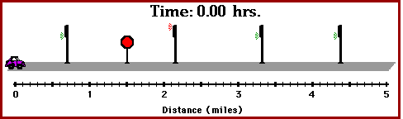
Average Speed
Most objects do not move at constant speeds for very long.
Think about how many stops you have to make on your way to school each day.
To calculate average speed, is the total distance divided by the total time.

Slide 34
What is average speed?
Speed is not constant.
For example, if you are running…
  Sometimes you will speed up
  Sometimes you will slow down
  Average Speed = Total Distance
                Total Time

Slide 35
Distance = rate * time
https://www.brainpop.com/math/algebra/distancerateandtime/
(3:36)
This video is more complicated than what we are doing but gives you an idea of how this could be used.

Slide 36

DON’T FORGET
Motion is something that is part of your everyday life. Motion refers to bodies moving. Automobiles, the earth, people, and many other things are in motion. To understand motion, the meaning of the terms speed, velocity, and acceleration must be understood. Speed is the distance traveled by a moving object in a given time. To determine speed, the distance traveled is divided by time.
The formula is
speed = distance / time

Slide 37



Velocity
Knowing the speed of an object will not tell you everything about its motion.
Velocity is the SPEED & DIRECTION of and object.
Velocity changes if either speed or direction changes.
With storms, you need to know the velocity of its motion !

Slide 38

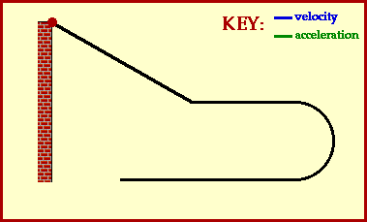
Acceleration
Acceleration is the rate at which velocity changes.
It refers to increasing speed (of course), decreasing speed (deceleration), or changing direction.

Slide 39

Calculating Acceleration
To determine the acceleration of an object, you must calculate the change in velocity during each unit of time.
The formula for this is:
  Acceleration = Final velocity –Initial velocity/Time

Slide 40



Calculating Acceleration
Lets Try:
  A car advertisement states that a certain car can accelerate from rest to 90 km/h in 9 seconds. Find the car’s average acceleration.
  An bird accelerates from 15 m/s to 23 m/s in 4 seconds. What is the eagle’s average acceleration?

Slide 41
What is the difference between speed and velocity?
Speed is distance over time
Velocity is speed in a direction

