Slide 1
Science Thoughts 9/5
What is inertia?
An object’s resistance to change of motion

Slide 2
Table of Contents
47 – Newton’s Laws Notes – finish from Friday
48 - Science Thoughts 9/5– 9/8
(1 page – you write) 49 - Nerd Words activity 2
(1 page – you write) 50 - Reflection 9/5 – 9/8
(1 page – you write) 51 – Force and Motion
(1 page - worksheet)

Slide 3
Today in class
Review # 47 notes
Forces and Motion #51

Slide 4
Newton’s FIRST law - Inertia
Tendency of objects to
resist any change in
motion
Reason a moving object
stays in motion with the
same velocity unless a
force changes its speed or
direction or both.

Slide 5
What is inertia?
Inertia is the resistance of any physical object to any change in its state of motion, including changes to its speed and direction.
Inertia tells us the we need a force to get an object to move or stop an object from moving.

Slide 6
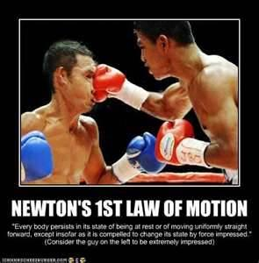
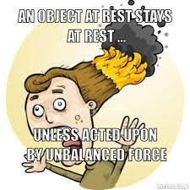
Newton’s FIRST Law
An object will not start moving until a force acts upon it
An object will stay in motion forever unless an unbalanced force acts upon it

Slide 7
Newton’s SECOND Law
Change in motion (direction or speed) of an object is
Proportional to the applied force
Inversely proportional to the mass.
F = ma
Speed Up? = Need More Force
Gain More mass? = go slower

Slide 8
Newton’s SECOND Law
Change in motion (direction or speed) of an object is
Proportional to the applied force
Inversely proportional to the mass.
F = ma
Add more Force to Go Faster
Larger objects are harder to move

Slide 9
Exploring Forces
We will look at three examples of forces:
Friction
Gravity
Magnets

Slide 10
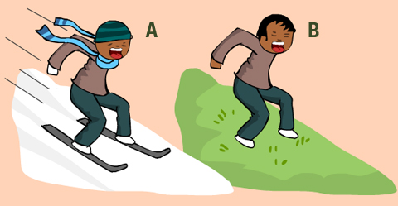
Friction
Force that opposes motion
Between two surfaces that are in contact
Amount depends on factors
Roughness of the surfaces
Force pushing the surfaces together

Slide 11
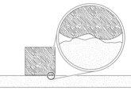
Friction
•Friction is the force that opposes the motion between two surfaces that touch.
•The surface of any object is rough.
•Even an object that feels smooth is covered with tiny hills and valleys.
•The contact between the hills of valleys of two surfaces causes them to stick, resulting in friction.

Slide 12
Friction
•The amount of friction depends on:
–Roughness of the surfaces
–Force pushing the surfaces together

Slide 13
Complete Force and Motion Online Lab
KuropasScience.weebly.com

Slide 14
Science Thoughts 9/6
What causes friction?
Contact between surfaces – the rougher the surface – the more friction.

Slide 15
Today in class
Log into Discovery Education
Username: wcp and lunch # Password: lunch #​
Complete "Slippery Slope" exploration
Fill in data chart and answer questions on worksheet
Any work not completed in class must be completed for homework

Slide 16
Science Thoughts 9/7
Why is it important to have a plan to deal with natural disasters?
Limit damage, injury, any emergency situations.

Slide 17
Hurricane Irma
Discuss how hurricanes form, travel, get energy and how to prepare for high winds, flooding and loss of electricity

Slide 18
Science Thoughts 9/8
In our labs this week, why did the car/block go farther when it started higher on the ramp?
Had more potential energy that converted to kinetic energy.

Slide 19
Sept 8 in class
Finish all labs
Study jams
Forces and motion
Slippery slope
Watch 2 magnets videos (15 minutes and 20 minutes)
Complete Reflection and Nerd Words

