Slide 1
Science Thoughts 9/25
How does a simple machine make work easier?
Reduces the amount of force needed to do the same work.

Slide 2
What is a Simple Machine?
A simple machine has few or no moving parts.
Simple machines make work easier

Slide 3
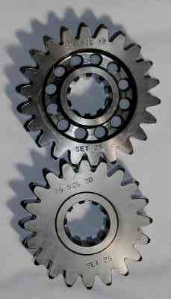
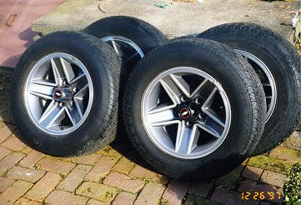
Wheels and Axles
The wheel and axle are a simple machine
The axle is a rod that goes through the wheel which allows the wheel to turn
Gears are a form of wheels and axles

Slide 4
What is a wheel and axle?
A wheel and axle is a modification of a pulley.
A wheel is fixed to a axle. The wheel and axle must move together to be a simple machine.
Sometimes the wheel has a crank or handle.

Slide 5
Examples of wheel and axles include roller skates and doorknobs. https://www.brainpop.com/technology/simplemachines/wheelandaxle/ (1:42)

Slide 6
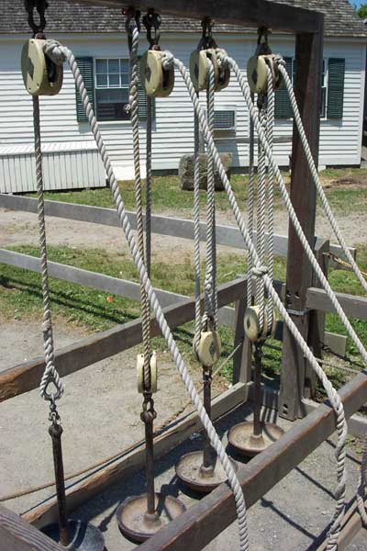
Pulleys
Pulley are wheels and axles with a groove around the outside
A pulley needs a rope, chain or belt around the groove to make it do work

Slide 7
What is a PULLEY?
A simple machine made with a rope, belt or chain wrapped around a grooved wheel. A pulley works two ways.

Slide 8
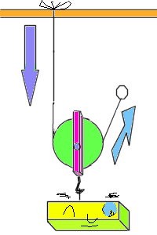
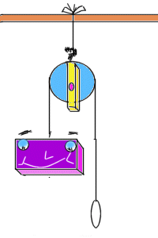
Diagrams of Pulleys https://www.brainpop.com/technology/simplemachines/pulley/ (2:09)
Fixed Pulley:
Movable Pulley:

Slide 9
How does a pulley work?
A pulley works two ways.
It can change the direction of a force or it can change the amount of force.

Slide 10
Fixed pulley
Does not multiply force.
Changes the direction of the effort force.
Mechanical advantage is equal to one.

Slide 11
How does a fixed pulley work?
A fixed pulley changes the direction of the applied force.
( Ex. raising a flag )

Slide 12
Movable pulley
Multiplies effort force but cannot change direction of the effort force.
Mechanical advantage is the effort distance divided by the resistance distance.

Slide 13
How does a moveable pulley work?
A movable pulley is attached to the object that is being moved.

Slide 14
Pulley system
A combination of fixed and movable pulleys.
Mechanical advantage is equal to the number of supporting ropes.

Slide 15
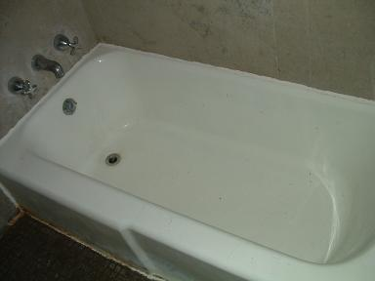
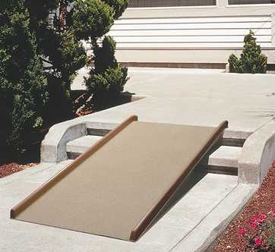
Inclined Planes
An inclined plane is a flat surface that is higher on one end
Inclined planes make the work of moving things easier
Notes:
A sloping surface, such as a ramp. An inclined plane can be used to alter the effort and distance involved in doing work, such as lifting loads. The trade-off is that an object must be moved a longer distance than if it was lifted straight up, but less force is needed. You can use this machine to move an object to a lower or higher place. Inclined planes make the work of moving things easier. You would need less energy and force to move objects with an inclined plane.

Slide 16
What is an inclined plane?
A simple machine with no moving parts. It is simply a straight slanted surface. ( Ex. a ramp.)
https://www.brainpop.com/technology/simplemachines/inclinedplane/(2:16)

Slide 17
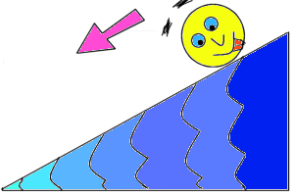
Diagram of Inclined Plane

Slide 18
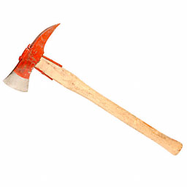
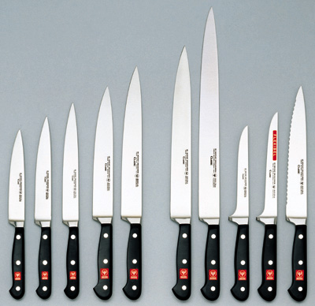
Wedges
Two inclined planes joined back to back.
Wedges are used to split things.

Slide 19
What is a wedge?
A modification of an inclined plane that moves .
It is made of two inclined planes put together.
Instead of the load being moved up an inclined plane, the inclined plane moves the load.

Slide 20
Diagram of Wedge
www.angelfire.com/scifi/dschlott/ simplemachines.html

Slide 21
Screws
A screw is an inclined plane wrapped around a shaft or cylinder.
The inclined plane allows the screw to move itself when rotated.

Slide 22
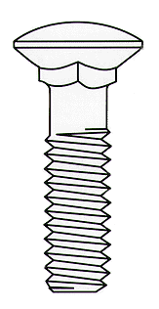
What is a screw?
A simple machine that is like an inclined plane.
It is an inclined plane that wraps around a shaft.

Slide 23
Describe LEVER
A simple machine made with a rigid bar free to pivot (move) around a fixed point called a fulcrum
https://www.brainpop.com/technology/simplemachines/levers/ (2:40)
THREE TYPES:

Slide 24
Diagrams of Levers
Effort force = input force Load – output force

Slide 25
Diagrams of Levers

Slide 26
Levers-First Class
In a first class lever the fulcrum is in the middle and the load and effort is on either side
Think of a see-saw

Slide 27
A first class lever is like a teeter-totter or see-saw. One end will lift an object (child) up just as far as the other end is pushed down.

Slide 28
Levers-Second Class
In a second class lever the fulcrum is at the end, with the load in the middle
Think of a wheelbarrow

Slide 29
A second class lever is like a wheel barrow. The long handles of a wheel barrow are really the long arms of a lever.

Slide 30
Levers-Third Class
In a third class lever the fulcrum is again at the end, but the effort is in the middle
Think of a pair of tweezers

Slide 31
A third class lever is like a fishing pole. When the pole is given a tug, one end stays still but the other end flips in the air catching the fish.

Slide 32
Simple Machines
Simple Machines can be put together in different ways to make complex machinery

Slide 33
Science Thoughts 9/26
What TWO things must happen in order for there to be WORK done?
A force must applied to an object
The object must move in the same direction as the force.

Slide 34
How do machines make work easier?
They can change the amount of force
They can change the distance
(Remember that Work = Force X Distance)
They can also change the direction

Slide 35
How do machines make work easier?
Any change in the size of the force changes the distance.
No machine can increase both force and distance.
Multiply force which decreases distance the load moves.
Multiply the distance the load moves which decreases force.
Or, they leave force and distance alone but change the direction in which the load moves.

Slide 36
Calculating Mechanical Advantage

Slide 37
Science Thought 9/27 What is mechanical advantage?
The number of times a machine multiplies the effort or input force.

Slide 38
Today in class
Review for UNIT Test
Work on Rube Goldberg project

Slide 39
Science Thought 9/28 What are the 6 types of simple machines?
There are three simple machines:
The lever, the pulley, and the inclined plane
The wheel and axle, the wedge, and the screw are modifications of these simple machines.

Slide 40
Today in class
Unit Test
Work on Rube Goldberg project

Slide 41
Science Thought 9/29 What is a compound (or complex) machine?
A machine made up of two or more simple machines.

Slide 42
Today in class
Finish Rube Goldberg Project

