Slide 1
Science Thoughts 10/23
What is an atmosphere?
An atmosphere is a layer of gases surrounding a planet or other material body, that is held in place by the gravity of that body.

Slide 2
Atmosphere and Weather
Composition and Layers of the Earth’s Atmosphere
Air Quality
Water Cycle and Precipitation and Clouds
Winds
Air Movement and Patterns
Weather Prediction
Severe Weather

Slide 3
This Week
Pre Test
Stations
Book work
Drawing
Vocabulary
Vocabulary Quiz on Thursday

Slide 4
Science Thoughts 10/24
What are the two most common elements found in the Earth’s atmosphere?
Nitrogen and Oxygen

Slide 5
Activities to be completed by end of class Thursday
1.1 earths atmosphere supports life 2 column notes
1.2 the sun supplies the atmospheres energy 2 column notes
Atmosphere vocabulary TIP chart
Modeling earths atmospheric layers

Slide 6
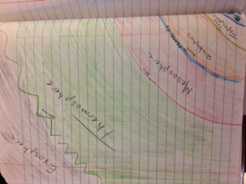
Modeling the Earth’s Atmospheric Layers There is a class set of directions. You need to return the directions when you are done.

Slide 7
Science Thoughts 10/25
What are cycles?
A series of events or actions that repeat themselves regularly; a physical and/or chemical process in which one material continually changes location and/or form.

Slide 8
Activities to be completed
1.1 notes from textbook
1.2 notes from textbook
1.1 – 1.4 TIP vocabulary
Modeling the Earth’s Atmosphere
Nerd Words
Reflection

Slide 9
Modeling the Earth’s Atmospheric Layers There is a class set of directions. You need to return the directions when you are done.

Slide 10
Science Thoughts 10/26
Put the four layers of the atmosphere mentioned in the book in order from closest to farthest away from Earth:
Mesosphere, Thermosphere, Troposphere, Stratosphere.
Troposphere
Stratosphere
Mesosphere
Thermosphere

Slide 11
Vocabulary Quiz
On google classroom
Then work on
completing classwork

Slide 12
Completed by end of class
1.1 notes from textbook
1.2 notes from textbook
1.1 – 1.4 TIP vocabulary
Modeling the Earth’s Atmosphere
When done: Nerd Words & reflection

Slide 13
Modeling the Earth’s Atmospheric Layers

Slide 14
Science Thoughts 10/27
What are the three ways the the atmosphere moves energy?
Radiation
Conduction
Convection

Slide 15
Today in class
Layers of the Atmosphere Notes
Brainpop videos
Ozone Article

Slide 16
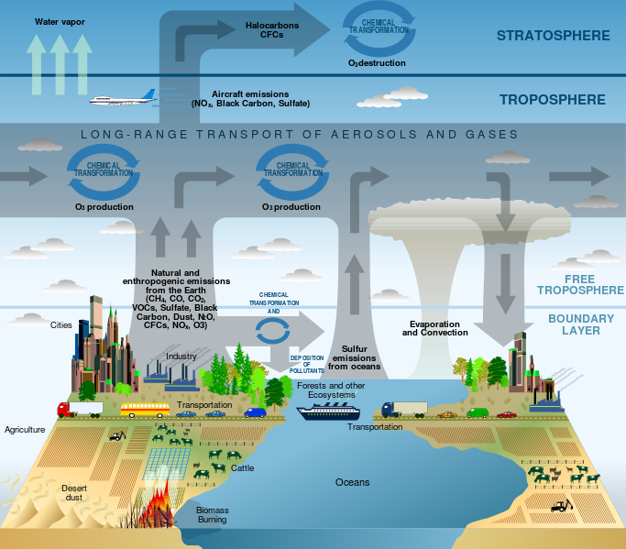
Earth’s Atmosphere Notes

Slide 17
Agree/Disagree
Earth’s atmosphere is mostly oxygen. Agree/Disagree
Air is weightless. Agree/Disagree
Without the atmosphere, we would burn up Agree/Disagree
We live in the warmest part of the atmosphere. Agree/Disagree
Our atmosphere is over 100 miles thick. Agree/Disagree

Slide 18
Agree/Disagree
Earth’s atmosphere is mostly oxygen. Agree/Disagree
Air is weightless. Agree/Disagree
Without the atmosphere, we would burn up. Agree/Disagree
We live in the warmest part of the atmosphere. Agree/Disagree
Our atmosphere is over 100 miles thick. Agree/Disagree

Slide 19
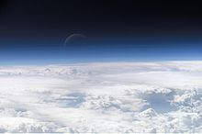
Atmosphere
Definition
A layer of gases surrounding the planet Earth
2 Ways It Makes Life Possible
Absorbs UV radiation
Warms the surface through heat retention

Slide 20
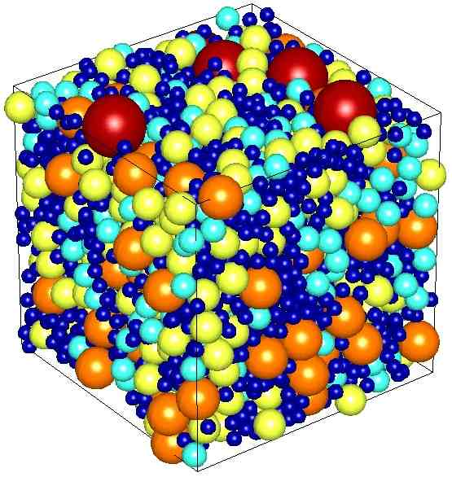
Characteristics
Altitude
The height of an object or point in relation to sea level or ground level.
Density
Refers to how closely "packed" or "crowded" the air molecules appear to be
As Altitude Increases
Density Decreases

Slide 21
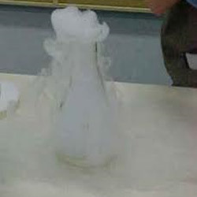
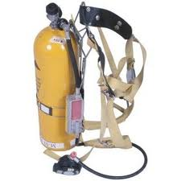
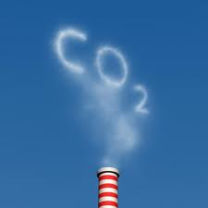
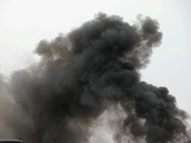
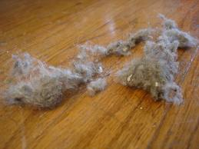
Materials (Give Examples)
Gases
Oxygen (21%)
Nitrogen (78%)
Carbon Dioxide
Helium
Particles
Dust
Smoke
Pollen
Label the Chart:
Nitrogen
Oxygen
Trace

Slide 22
Gases (Explain their purpose)
Nitrogen
Plants require nitrogen for their growth and development.
Oxygen
Supports life and metabolic processes
Carbon Dioxide
Plants need it for photosynthesis, emitted from animals during respiration, warms the atmosphere by absorbing infrared radiation
Water Vapor
Precipitation, weather, warms the atmosphere by absorbing infrared radiation

Slide 23
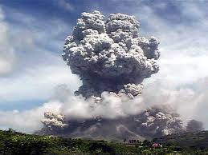
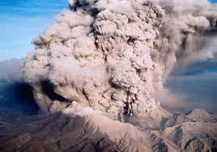
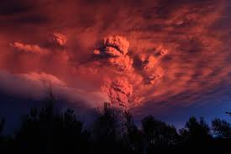
Sudden Changes (List & Define)
Volcanic Eruptions
Ash flies out of the top of it and then the air is filled with a thick smoke and ash. The ash then spread outs, and forms an ash cloud. It contains greenhouse gases such as methane and carbon dioxide, which contributes to global warming. It may result in acid when rain falls from the ash clouds. It may also block out vision after ashes haze the air.
If the resulting ash cloud is large enough, the eruption can cause a short-term cooling by blocking sunlight as it spreads throughout much of the world.

Slide 24
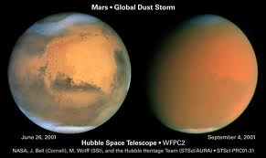
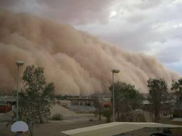
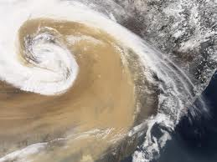
Sudden Changes (List & Define)
Dust Storms
Dust particles have a radioactive effect on climate through reflection and absorption of solar radiation. It can lead to severe cooling days or hot days depending on dust particles’ properties and on what part of the atmosphere they are found.

Slide 25
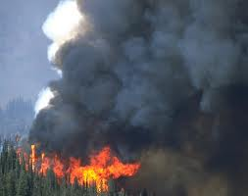
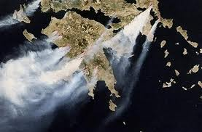
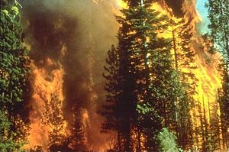
Sudden Changes (List & Define)
Forest Fires
Wildfires can affect climate and weather and have major impacts on atmospheric pollution. Wildfire emissions contain fine particulate matter which can cause cardiovascular and respiratory problems.

Slide 26
https://www.brainpop.com/science/earthsystem/earthsatmosphere/ 2:52
https://www.brainpop.com/science/earthsystem/ozonelayer/ 2:58
Ozone Article and Summary

