Slide 1
Science Thoughts 11/13
What two characteristics are used to categorize clouds?
What they look like and altitude.

Slide 2
Hurricane Project/Review
We will spend the five days this week completing the Hurricane Project in the Learning Commons. All Research and Presentations should be completed by the end of class on Friday.
11/17 – WONDER questions (minor grade)
11/21 – INVESTIGATE research (minor grade)
12/13 – SYNTHESIZE research and organization (minor grade)
12/15 – EXPRESS presentation material (group major grade)
12/21 – EXPRESS group presentation (group major grade)
PROJECT WILL NOT BE ACCEPTED LATE!

Slide 3
Today in Class
Learning Commons to
listen to Mrs. Morris read
and continue WONDER

Slide 4
Science Thoughts 11/14
Which type of cloud produces thunderstorms, tornadoes and other intense weather situations?
Cumulonimbus

Slide 5
Today in class
Water Cycle Quiz
Study Jams: Weather and Climate
The Water Cycle
Air Masses and Fronts
Air Pressure and Winds
Clouds and Precipitation
Weather Instruments

Slide 6
Science Thoughts 11/15
What is the difference between Maritime and Continental Air Masses?
Maritime have moisture, Continental do not have moisture.

Slide 7
Today in class
Notes on air masses
Air fronts

Slide 8
AIR MASSES

Slide 9
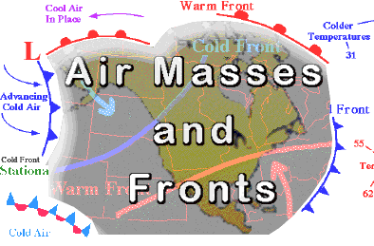
Air Masses and Fronts

Slide 10
Air Mass:
An air mass is a huge body of air that has similar temperature, humidity, and air pressure at any given height.
Air masses are classified by 2 characteristics
Temperature and Humidity
The characteristics of an air mass depend on the temperatures and moisture content of the region over which the air mass formed.
Tropical: warm, air masses formed in the tropics
Polar: cold, air masses form near north or south pole
Maritime: air masses formed on oceans or seas
Continental: air masses formed over land

Slide 11
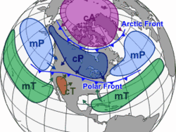
The colder the air the higher the air pressure subsequently the hotter the air the lower the air pressure.
Cold air → more dense
Hot air → less dense
There are 4 major types of air masses that affect the weather of the U.S.
Maritime tropical
Maritime polar
Continental tropical
Continental polar

Slide 12
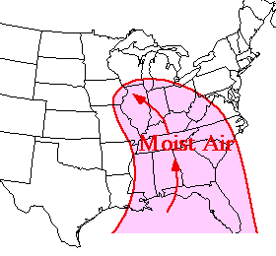
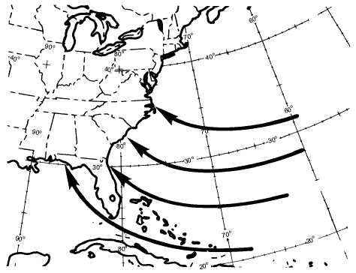
Maritime tropical
Warm, wet air masses
On the east coast they are formed over the Gulf of Mexico & south Atlantic Ocean.
Influence weather along the entire east coast.
Summer: thunderstorms & summer showers
Winter: heavy snow or rain
On the west coast they form over the southern Pacific Ocean.

Slide 13
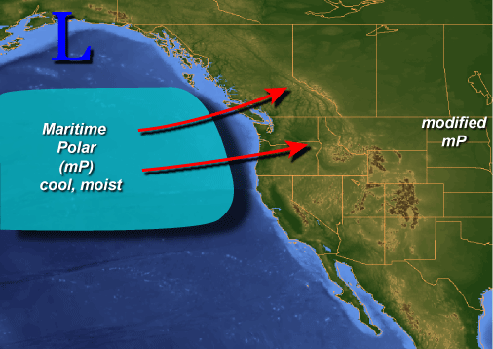
Maritime polar
Cold, wet air masses
On the east coast they are
formed over the north Atlantic.
On the west coast they are
formed over the north Pacific.
Influence the weather of the west coast more so than that of the east coast.
Summer/Winter: fog, rain, & cooler temperatures

Slide 14
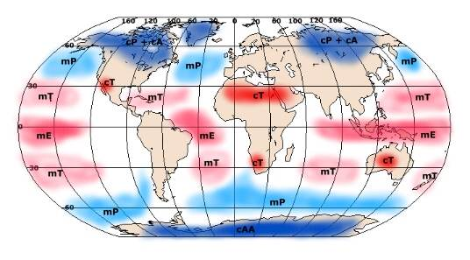
Continental tropical
Warm, dry air masses
Typically form over the southwest (New Mexico, Arizona, Nevada, as well as northern Mexico) during the summer months.
Influence the weather of the southwestern part of the US & southern Great Plains (Kansas, Oklahoma, Texas, Iowa).
Summer: Hot, dry

Slide 15
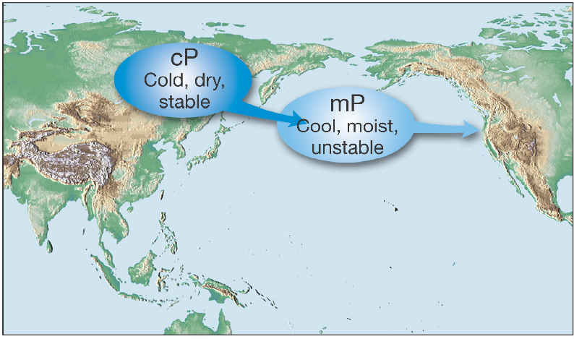
Continental polar
Cold, dry air masses
Typically form over
central & northern Canada
as well as Alaska.
Influence the weather of the entire United States.
Winter: Clear, cold, dry
Summer: Potential for storms due to interaction with Maritime tropical air moving up from the Gulf of Mexico.

Slide 16
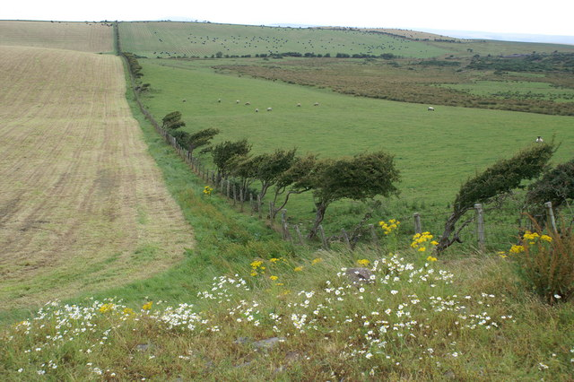
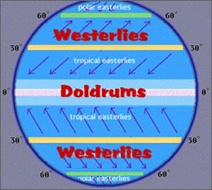
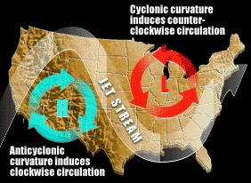
2 primary methods for air mass movement
Prevailing Westerlies
Pushes air masses from west to east.
Jet streams
Pushes fast moving air masses from west to east.

Slide 17
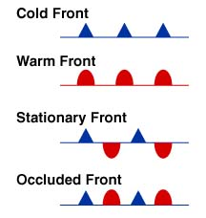
4 types of fronts
Each bring different types of weather

Slide 18
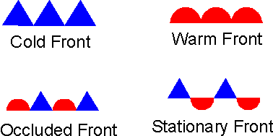
The boundary between two air masses.
Air masses do not easily mix with each other due to the differences in…
Density (Air pressure)
Temperature
Moisture content
Storms & different types of weather phenomena occur along fronts.

Slide 19
Cold front
Occurs when a polar (cold) air mass runs into a tropical (warm) air mass
The warm air is less dense and gets pushed above the cold air mass

Slide 20
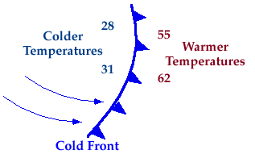
Cold Front
Temperatures drop, and there is usually precipitation
Thunderstorms are usually a result of a cold front

Slide 21
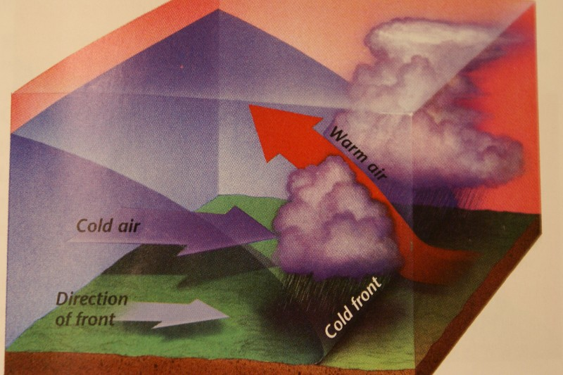
Fronts
Cold front
Fast moving cold air mass overtakes a slower moving warm air mass.
Can cause abrupt weather changes particularly thunderstorms.
Clear skies, a change in wind, & lower temperatures usually follow a cold front.
http://www.youtube.com/watch?v=XcHHiULyrPY

Slide 22
Warm Front
Occurs at the place where a warm air mass replaces a cold air mass
The warm air mass is less dense and will slowly push the cold air, eventually rising above it

Slide 23
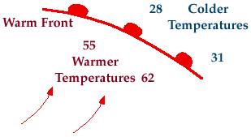
Warm Front
Results in warmer temperatures
Usually precipitation

Slide 24
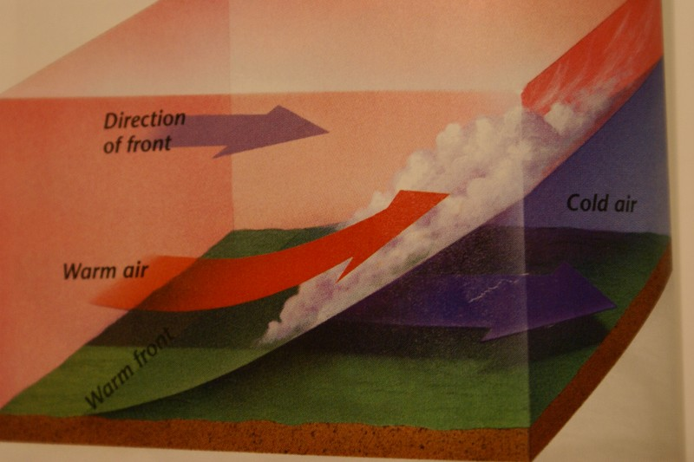
Warm front
A fast moving warm air mass overtakes a slow moving cold air mass.
Can cause extended periods of rainy or cloudy weather.
Warm, humid weather usually follows a warm front.
http://www.youtube.com/watch?v=huKYKykjcm0&feature=related

Slide 25
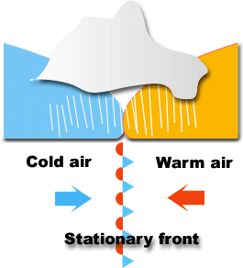
Stationary Front
Occurs when neither the warm air or the cold air is advancing
The less dense warm air will rise above the cold air

Slide 26
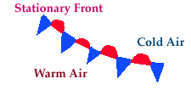
Stationary Front
Clouds and precipitation occur
If a stationary front stays for too long, flooding can occur

Slide 27
Stationary front
A cold and warm air mass meet but neither can move the other.
Can cause extended periods of precipitation; snow, rain, fog or clouds.

Slide 28
Occluded front
A warm air mass is caught between 2 cooler air masses.
http://www.phschool.com/atschool/phsciexp/active_art/weather_fronts/

Slide 29
Cyclones (Greek for “wheel”)
Formed around centers of low pressure.
Caused as the boundary between fronts become distorted by surface features; mountains or strong winds.
Represented on weather maps by an L.
Warm air rises and spins counterclockwise around the center.
Storms and precipitation are associated with areas of low pressure.

Slide 30
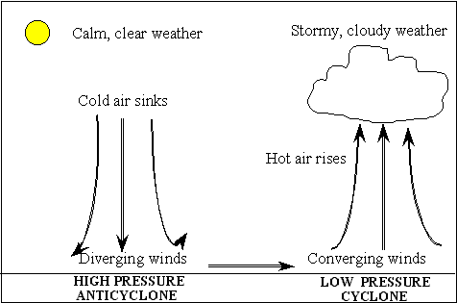
Anticyclones
Formed around centers of high pressure.
Represented on weather maps by an H.
Cold air sinks and spins clockwise around the center.
Dry weather and clear skies are associated with areas of high pressure.

Slide 31
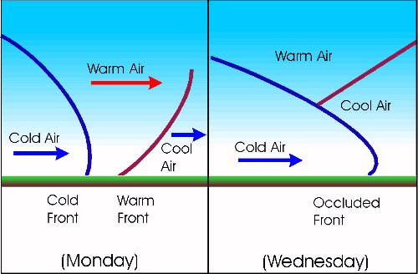
Occluded Front
Occurs when a cold front catches up with a warm front
Cold fronts move twice as fast as warm fronts

Slide 32
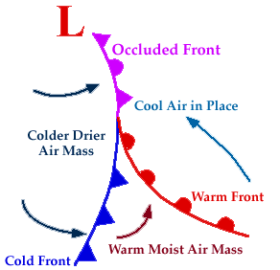
Occluded Front
Causes cloudiness and precipitation

Slide 33
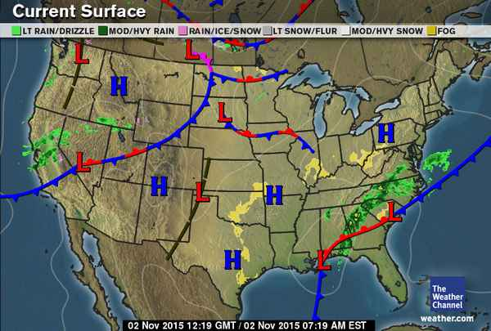
Weather Map

Slide 34
Science Thoughts 11/16
What is the difference between Tropical and Polar Air Masses?
Tropical are warm,
Polar are cold.

Slide 35
Today in class
https://www.brainpop.com/science/weather/weather/ (3:40)
Book Work – 3.1, 3.2 and 3.3
Pages A82 - A96
WONDER

Slide 36
Hurricane Project/Review
We will spend the five days this week completing the Hurricane Project in the Learning Commons. All Research and Presentations should be completed by the end of class on Friday.
11/17 – WONDER questions (minor grade)
11/21 – INVESTIGATE research (minor grade)
12/13 – SYNTHESIZE research and organization (minor grade)
12/15 – EXPRESS presentation material (group major grade)
12/21 – EXPRESS group presentation (group major grade)
PROJECT WILL NOT BE ACCEPTED LATE!

Slide 37
Science Thoughts 11/17
What are the four types of weather fronts?
Cold, Warm, Stationary, Occluded

Slide 38
Today in class
Book Work – 3.1, 3.2 and 3.3
(due Monday 11/27)
WONDER
(due today)
https://www.schooltube.com/video/38688c519c4b4eb689a9/Bill%20Nye%20Atmosphere (23:07)

Slide 39
Learning Commons
11/20 and 11/21
INVESTIGATE for project
(due 11/21)
Meet in Learning Commons tomorrow

Slide 40
Hurricane Project/Review
We will spend the five days this week completing the Hurricane Project in the Learning Commons. All Research and Presentations should be completed by the end of class on Friday.
11/17 – WONDER questions (minor grade)
11/21 – INVESTIGATE research (minor grade)
12/13 – SYNTHESIZE research and organization (minor grade)
12/15 – EXPRESS presentation material (group major grade)
12/21 – EXPRESS group presentation (group major grade)
PROJECT WILL NOT BE ACCEPTED LATE!

