Slide 1
February 27 – March 3

Slide 2
Science Thoughts 2/27
In one celled organisms, each cell supports the characteristics of life. How are plant and animal cells different from one celled organisms?
SPECIALIZATION

Slide 3
Monday in class
C 1.3
P 26 – 32
Different cells perform various functions.

Slide 4
Classified by cell type
Unicellular – Multicellular
Prokaryotic – Eukaryotic
Autotrophic – Heterotrophic

Slide 5
Multicellular – Eukaryotic cells Plant – Animal - Fungus
Specialization – each cell in the organism has a different job
Single cell of multicellular organism CAN NOT survive on its own
Members of a community that work together to support organism

Slide 6
NOT highly specialized
If piece is broken off organism
it will regenerate
grow back!

Slide 7
Complex organisms (most plant/animal)
Cells groups together with others that have the same job
Called TISSUE

Slide 8
Tissue working together
Different tissue working together for SAME FUNCTION
ORGAN

Slide 9
Organs working with other organs
Organs working with other organs to get a specific job done
ORGAN SYSTEM

Slide 10
All Organ systems working together
Multiple organ systems working together are all part of an organism
Organisms can have different numbers of organ systems

Slide 11
Science Thoughts 2/28
How are cells classified starting with individual cells and ending with organisms?
Cell – Tissue – Organ – Organ System - Organism

Slide 12
Tuesday in class
Power point Notes
https://www.youtube.com/watch?v=ZRFykdf4kDc (2:29)

Slide 13
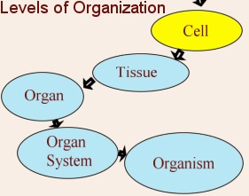
Levels of organization
7.L.1.3 – Summarize the hierarchical organization of multicellular organisms from cell → tissue → organ → organ system → organism.

Slide 14
Specialized
To have a specific function.
Example: A violinist.
Non-Example: One-man band.

Slide 15
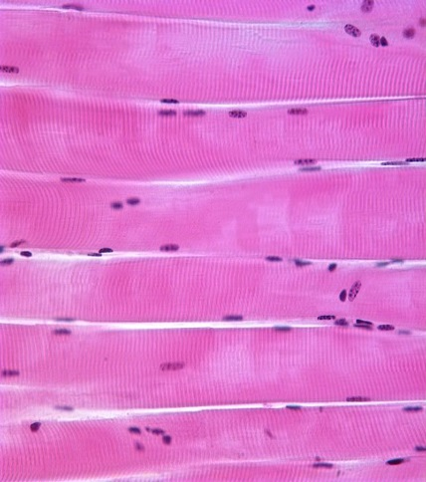
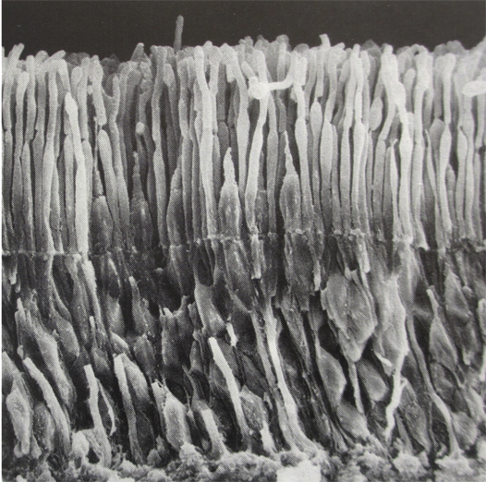
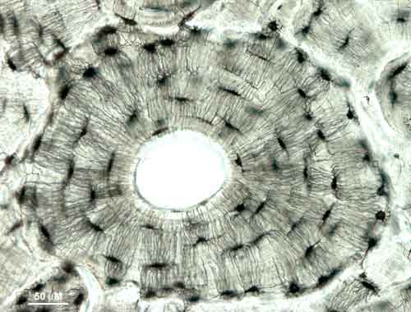
Cell
Smallest living thing
Examples: Muscle cells, Bone cells, Skin cells, Eye cells, Blood cells, Neurons (brain cells)
Non-Examples: Biceps, Triceps, Ear, Eye, Brain, Organelles

Slide 16
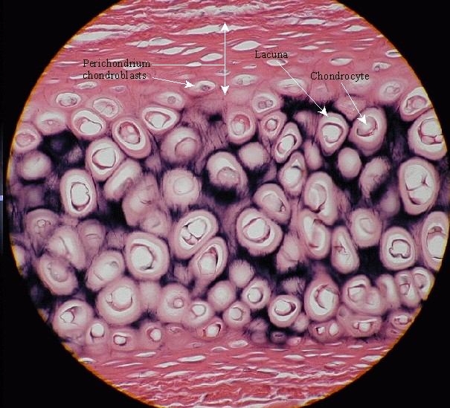
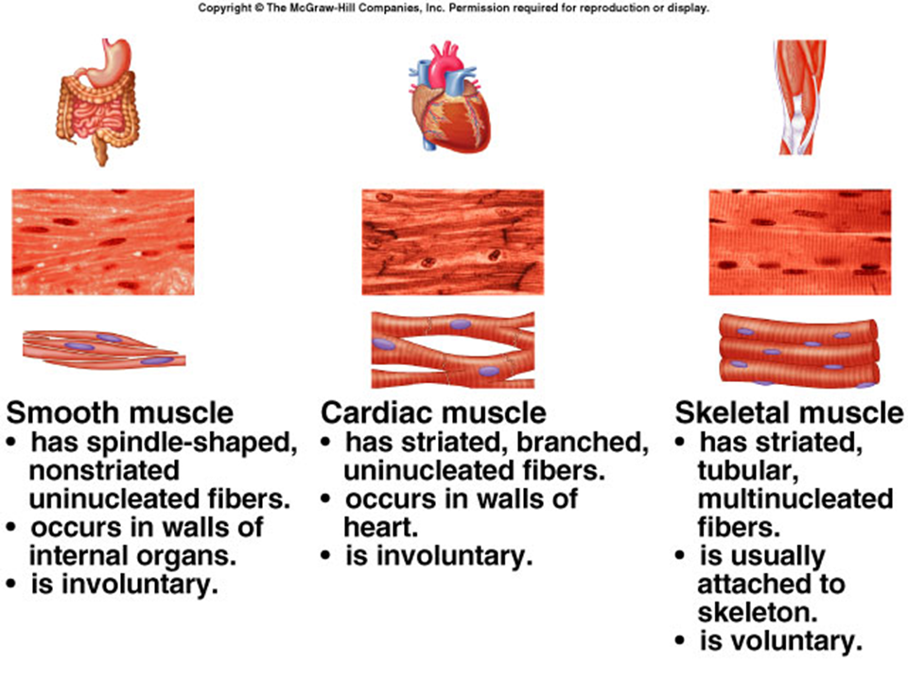
Tissue
Group of cells working together to perform the same function.
Examples: Muscle, Blood, Fat, Cartilage, Epithelial
Non-Examples: Neurons, Muscle Cells, Femur

Slide 17
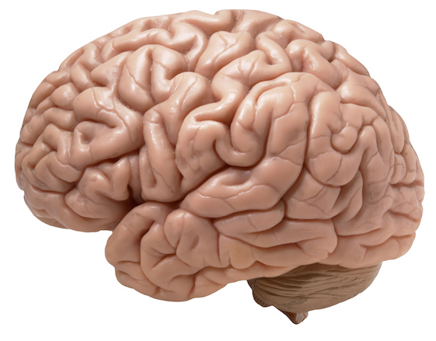
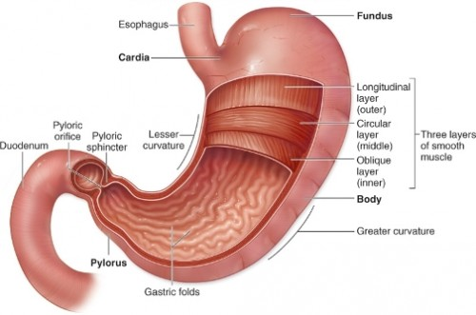
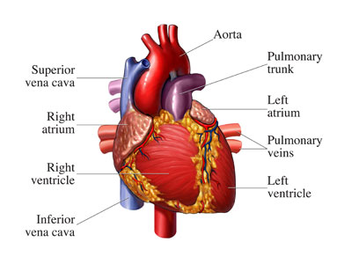
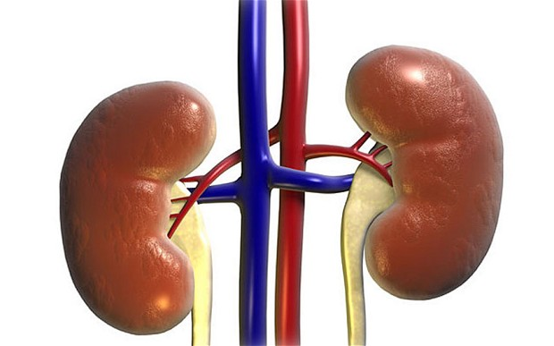
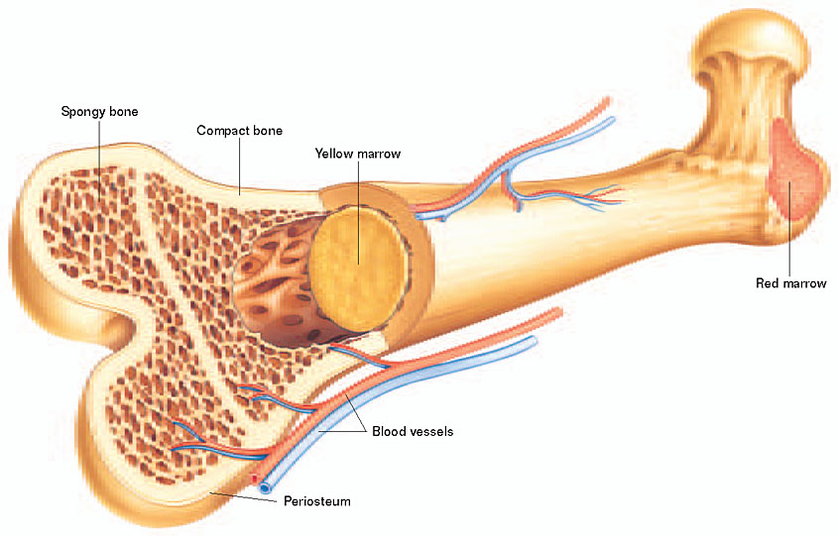
Organ
Group of tissues working together to perform the same function.
Examples: Stomach, Lungs, Skin, Brain, Heart, Bones, Kidneys
Non-Examples: Muscle, Blood, Hair, Adipose, Cartilage

Slide 18
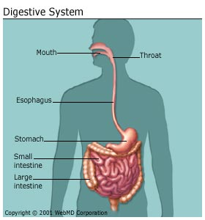
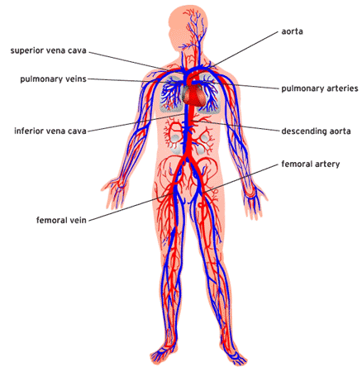
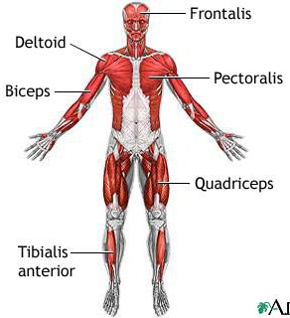
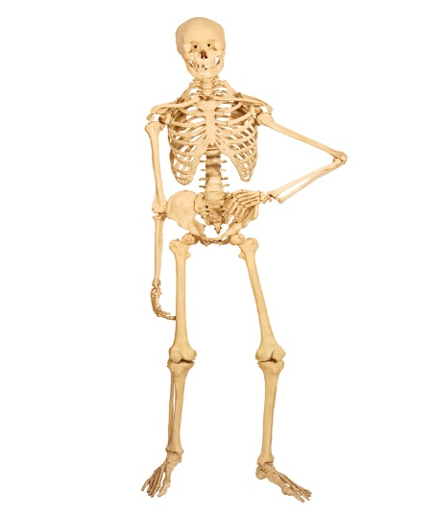
Organ System
Group of organs working together to perform the same function.
Examples: Digestive, Circulatory, Respiratory, Excretory, Nervous, Muscular, Skeletal.
Non-Examples: Heart, Lungs, Stomach, Bees, Trees, Kidneys

Slide 19
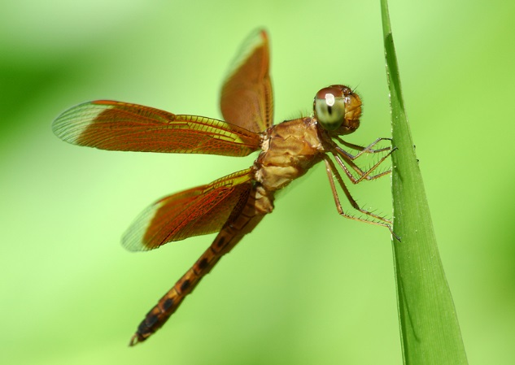
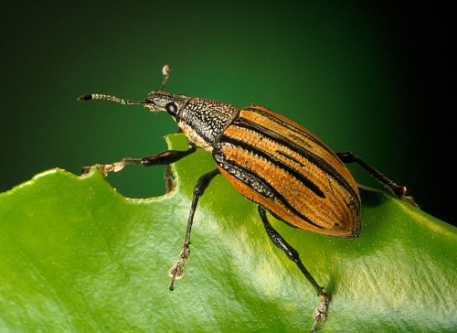
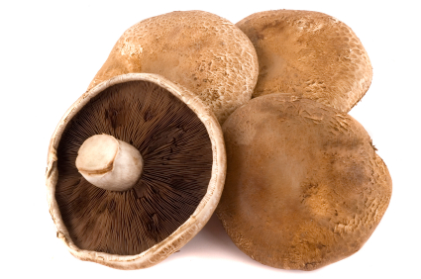
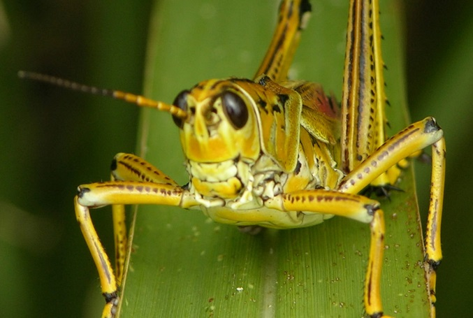
Organism
Object that performs all life functions.
Examples: Humans, Plants, Mushrooms, Insects
Non-Examples: Rocks, Viruses, Fire
Notes:
Locust, dragonfly, wood weevil

Slide 20
Answer questions 1 – 5 in 1.3 Review (p.32)
The three domains and their cell types are:
Specialization is
Levels of organization as a tree:
Difference between cell in unicellular and multicellular organism:
Using Models:
similar to object represented:
Different from object represented:
https://www.brainpop.com/science/cellularlifeandgenetics/cellspecialization/ (2:01)

Slide 21
Science Thoughts 3/1
Substitute – no science thought

Slide 22
Wednesday in class
Study guide for unit test
15 minutes – silent/individual
15 minutes – quiet/small group
15 minutes – get answers

Slide 23
Science Thoughts 3/2
What topics will be covered on Friday’s test?
Microscope
Cell theory
Organelles
Protists
Organization

Slide 24
Thursday in class
Review for Unit Test

Slide 25
Science Thoughts 3/3
What are the three tools you should use to study for the unit test in science?
Pretest (given 1st day)
Nerd Words
(objectives and questions)
Study Guide

Slide 26
Friday in class
Cells Unit Test
Genetics Pretest
Notebook check

