Slide 1
Digestion
Digestion: process of breaking down food into smaller, usable materials
1. The body needs energy and materials
a. Need food for energy
b. Need materials from food
Those materials are called nutrients
2. Nutrients include:
a. Water- no nutritional value but needed for bodily functions
b. Proteins: building blocks, used for cell growth and repair (muscles, bones, skins)
c. Carbohydrates: provide cells with energy (this is the glucose we use in respiration)
d. Fat: stores energy

Slide 2
Digestion
3. The digestive system moves and breaks down food
a. Peristalsis: moves food through the digestive system (contractions to push through)
Why we can swallow while on our heads
Mechanical digestion
a. teeth breaking food into smaller pieces
b. stomach breaks food by mashing and pounding
Chemical digestion
c. changes the chemical composition of food

Slide 3
Digestion
Materials are broken down as they move through the digestive tract
a. Mouth: both chemical and mechanical digestion (teeth, saliva)
b. Esophagus: muscle contractions of peristalsis move food from throat to stomach
c. Stomach: both mechanical and chemical
strong muscles here mix and mash food into smaller parts
hydrochloric acid (HCL) breaks down food chemically
acid could eat through stomach but we have a lining that is replaced every 3 days
also have some absorption of nutrients here

Slide 4
Digestion
d. Small intestine: partially digested food moves from stomach to SI
most of the nutrients made available during digestion are absorbed in the small intestine
structures called villi found here, they contain folds that absorb the nutrients.
Once absorbed by the villi, nutrients are absorbed by the circulatory system (talk about that later in year)
d. Large Intestine: water and some other nutrients are absorbed here
Most of the materiel left after water removed is waste and moves to the rectum

Slide 5
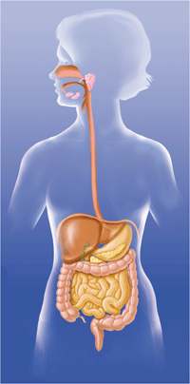
The digestive system breaks down food.
2.2
Structure
Function
mouth
Mouth
chemical and mechanical digestion
movement of food by peristalsis from mouth to stomach
esophagus
Esophagus
stomach
chemical and mechanical digestion; absorption of broken-down nutrients
Stomach
Small intestine
chemical digestion; absorption of broken-down nutrients
Large intestine
absorption of water and broken-down nutrients, elimination of wastes
small intestine
large intestine
SECTION
OUTLINE

