Slide 1
Tuesday in class Notes (foldable) on function of organelles:
Mitochondria
Golgi bodies
Endoplasmic reticulum
Vacuoles
Lysosomes
Ribosomes
Chloroplast

Slide 2
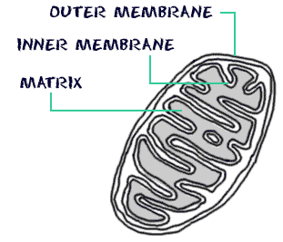
Mitochondria https://www.youtube.com/watch?v=pOfyuoa0Ywc (1:11)
are known as the powerhouses of the cell. They are organelles that act like a digestive system which takes in nutrients, breaks them down, and creates energy rich molecules for the cell. The biochemical processes of the cell are known as cellular respiration.

Slide 3
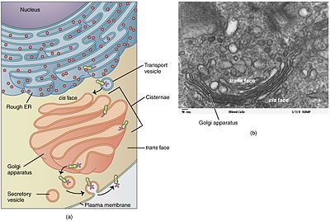
Golgi bodies https://www.youtube.com/watch?v=AGM76zrWe7M (1:04)
packages proteins into membrane-bound vesicles inside the cell before the vesicles are sent to their destination

Slide 4
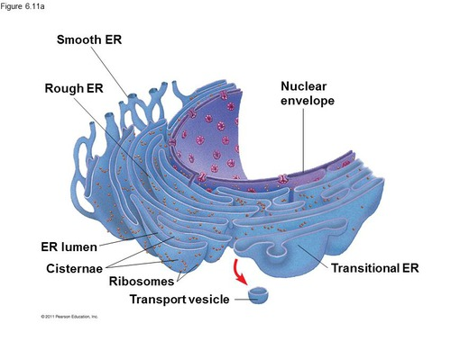
Endoplasmic reticulum https://www.youtube.com/watch?v=DJCJi9LirkU (1:37)
serves many general functions, including the folding of protein molecules in sacs called cisternae and the transport of synthesized proteins in vesicles to the Golgi apparatus

Slide 5
Vacuoles https://www.youtube.com/watch?v=evW93DtSoZY (3:39)
storage bubbles found in cells. They are found in both animal and plant cells but are much larger in plant cells. Vacuoles might store food or any variety of nutrients a cell might need to survive. They can even store waste products so the rest of the cell is protected from contamination.

Slide 6
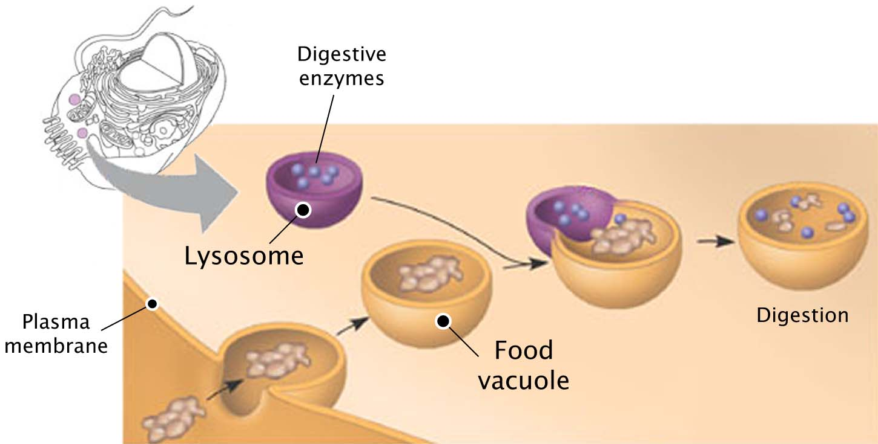
Lysosomes https://www.youtube.com/watch?v=cA-Ou_t2sag (1:00)
The lysosomes also act as the waste disposal system of the cell by digesting unwanted materials in the cytoplasm

Slide 7
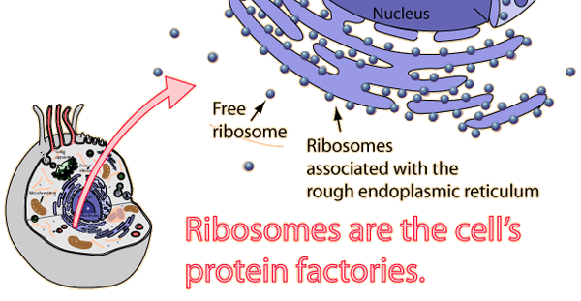
Ribosomes https://www.youtube.com/watch?v=kbB2kMkmb0w (2:06)
Ribosomes are the protein builders or the protein synthesizers of the cell. They are like construction guys who connect one amino acid at a time and build long chains.

Slide 8
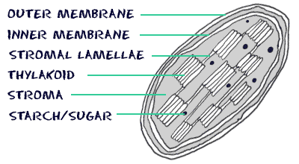
Chloroplast https://www.youtube.com/watch?v=eOPEn2qYff4&t=19s (4:18)
Chloroplasts work to convert light energy of the Sun into sugars that can be used by cells. The entire process is called photosynthesis and it all depends on the little green chlorophyll molecules in each chloroplast.

Slide 9
https://www.brainpop.com/science/cellularlifeandgenetics/cellstructures/ (2:13)
https://www.brainpop.com/science/cellularlifeandgenetics/cellspecialization/ (2:01)
Animal cells (11:34)
https://www.youtube.com/watch?v=cj8dDTHGJBY
Plant cells (10:27)
https://www.youtube.com/watch?v=9UvlqAVCoqY&t=245s
All organelles (1:30 each)
https://www.youtube.com/watch?annotation_id=annotation_449350&feature=iv&src_vid=4OLiDwjj_Bo&v=tdGjorwuEDw

