Slide 1
Science Thoughts 8/28
How can an object be accelerating if the speed is not changing?
Acceleration is change in VELOCITY so the DIRECTION is changing.

Slide 2
Table of Contents
39 - Science Thoughts 8/28 - 9/1
(1 page)
40 - Nerd Words List and activity
(2 pages)
41 - Reflection 8/28 - 9/1
(1 page)
42 – 2.1 to 2.2 bookwork
(4 pages)

Slide 3
Today in class
Prepare Notebook
Describing Motion Test
  Google classroom
Book work – 2.1 to 2.2

Slide 4
Science Thought 8/29
What causes acceleration?
A force applied to an object.

Slide 5
Today’s class
Notes on forces (#43)

Slide 6
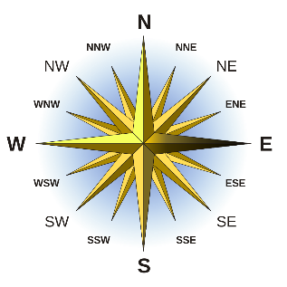
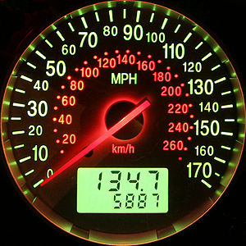
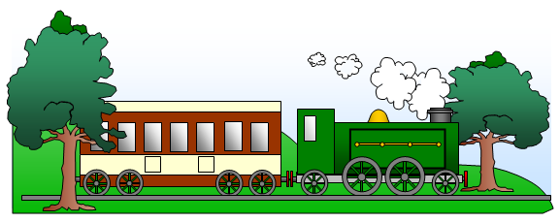
How can the motion of an object can be described?
When an object changes position over time relative to a reference point, the object is in motion
  Motion of an object
    Always judged with respect to some other object or point
    Can be described with a reference direction
      North, South, East, West, up or down
  Speed of an object
    Measure of how quickly the object gets from one place to another
  All motion is relative
    Frame of reference chosen
    There is no motionless frame from which we can judge all motion

Slide 7
Graphing Changes in Motion
Describing the motion of an object is occasionally hard to do with words.
  Graphs help make motion easier to picture, and therefore understand.
  Remember:
    Motion is a change in position measured by distance and time.
    Speed tells us the rate at which an object moves.
    Velocity tells the speed and direction of a moving object.
    Acceleration tells us the rate speed or direction changes.

Slide 8
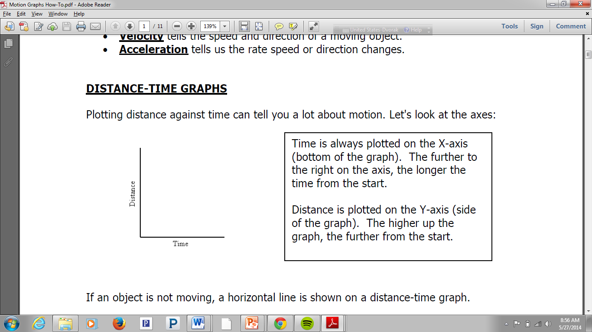
Graphing Changes in Motion

Slide 9
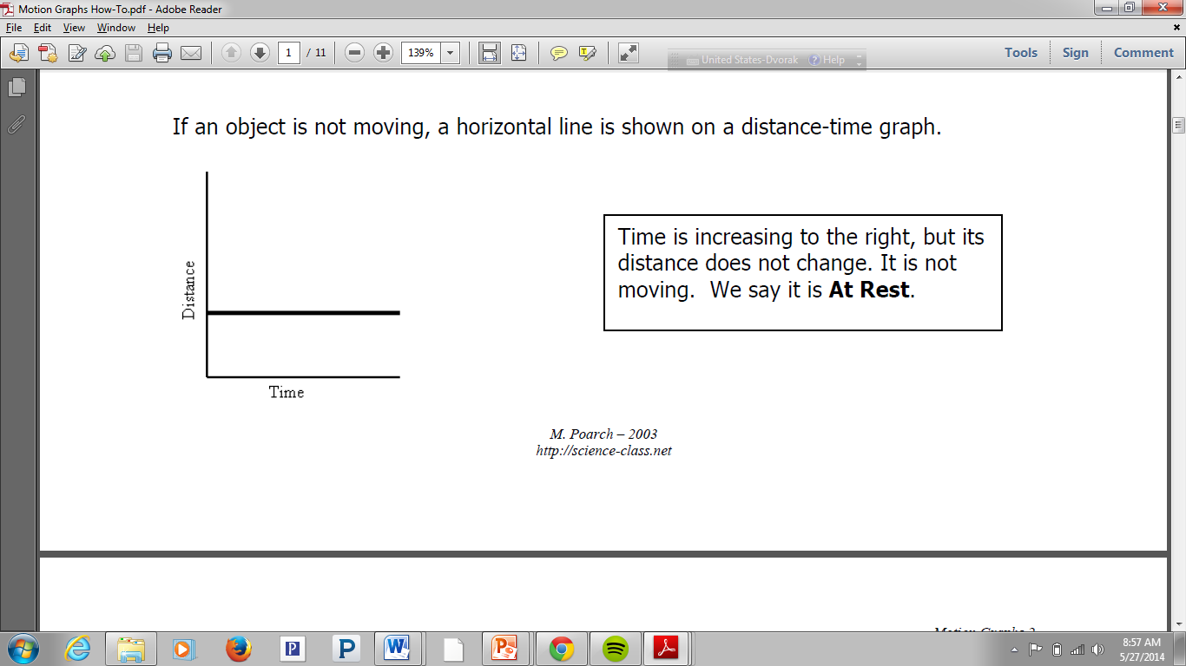
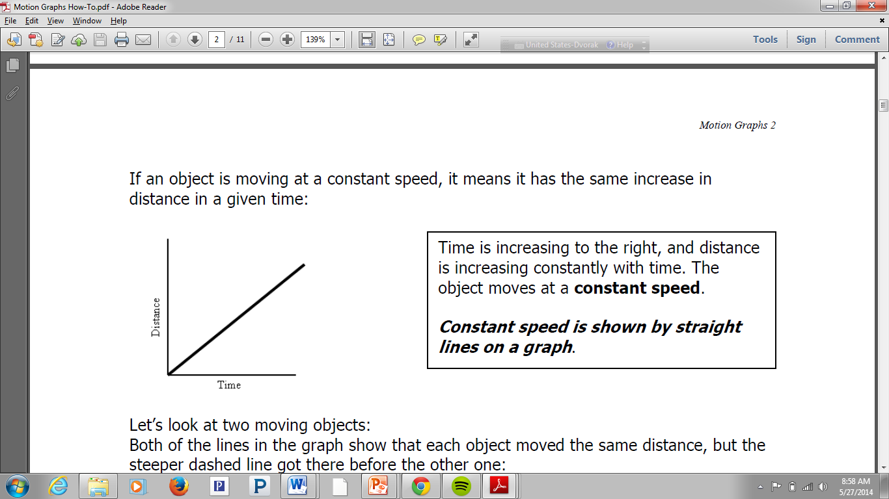
Graphing Changes in Motion

Slide 10
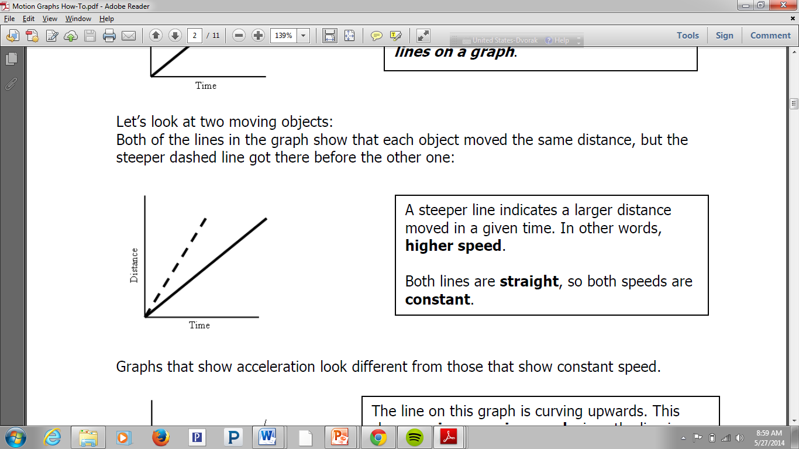
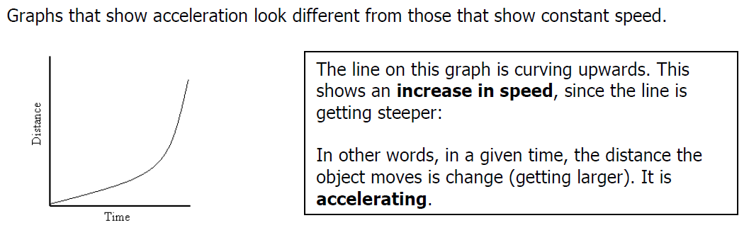
Graphing Changes in Motion

Slide 11
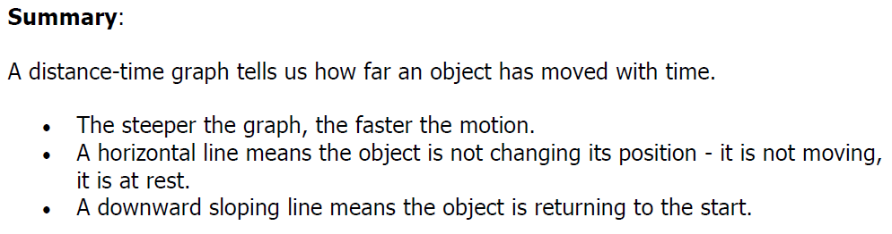
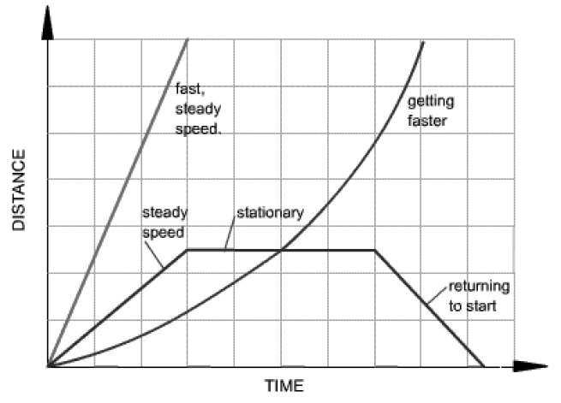
Graphing Changes in Motion

Slide 12
Balanced and Unbalanced Forces objective:
Explain the effects of balanced and unbalanced forces acting on an object (including friction, gravity and magnets)
https://www.brainpop.com/science/motionsforcesandtime/force/
(3 min)

Slide 13
When you ride a bike, your foot pushes against the pedal. The push makes
the wheels of the bike move.
When you drop something, it is pulled to the ground by gravity.
A PUSH or a PULL is a FORCE. So, a good definition for force is a push or pull in a particular direction.
Forces affect how objects move. They may cause motion; they may also slow, stop, or change the direction of motion of an object that is already moving

Slide 14
What is a force?
•In science, a force is a push or a pull.
•All forces have two properties:
Direction and Size (use VECTOR)
•A newton (N) is the unit that describes the size of a force.

Slide 15
Forces can affect motion in several ways:
→ They can make objects start moving
→ They can make objects move faster
→ They can make objects move slower
→ They can make objects stop moving
→ They can make objects change direction
→ They can make objects change shape

Slide 16
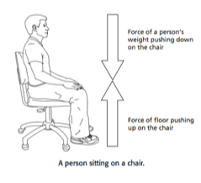
What is a force
•The student is pushing down on the chair, but the chair does not move.
•The floor is balancing the force by pushing on the chair.

Slide 17
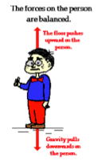
Balanced Forces
•When the forces on an object produce a net force of 0 N, the forces are balanced.
•There is no change in the motion of the object.

Slide 18
Since force cause changes in the speed or direction of an object, we can say that forces cause changes in velocity, so.... Forces cause acceleration!

Slide 19
Acceleration
Measures the change in an object’s velocity over time
(Time it takes to change speed)
Units include a distance and a time squared
Ex: mi/hr², m/s²

Slide 20
Types of Acceleration:
Same Direction of Motion AKA “Speeding Up”
+ =
A force is applied in the same direction causing the bike to speed up.

Slide 21
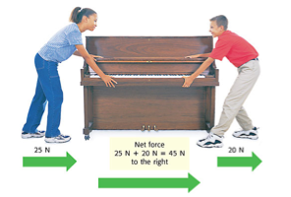
Forces in the Same Direction
•When forces are applied in the same direction, they are added to determine the size of the net force.

Slide 22
Types of Acceleration:
Opposite Direction of Motion AKA “Slowing Down”
  + =
A force is applied in the opposite direction causing the bike to slow down.

Slide 23
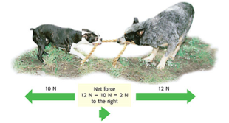
Forces in Different Directions
•When two forces act in opposite directions, you subtract the smaller force from the larger force to determine the net force.
•The net force will be in the same direction as the larger force.

Slide 24
Types of Acceleration:
At angle to motion AKA “Turning”
  + =
A force is applied at an angle causing the bike to change direction. The speed may not change!

Slide 25
FORCE FACTS:
→ Forces are measured in Newtons (N)
→ Forces usually act in pairs
→ Forces act in a particular direction
→ Forces usually cannot be seen, but their effects can

Slide 26
Combining Forces
•More than one force often acts on an object.
•When all the forces acting on an object are added together, you determine the net force on the object.
•An object with a net force more than 0 N on it will change its state of motion.

Slide 27
Net Forces
More than one force can act on an object at a time. The forces can push or pull in any direction.
What happens to the object when the forces act depends on two things:
→ How strong the forces are
→ The direction of the forces

Slide 28
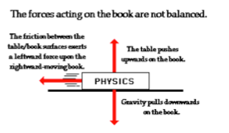
Unbalanced Forces
•When the net force on an object is not 0 N, the forces on the object are unbalanced.
•Unbalanced forces produce a change in motion of an object.

Slide 29
In summary!
If the effects of the forces don't cancel each other, if one force is stronger than others, the forces are unbalanced forces. Unbalanced forces cause a change in motion; speed and/or direction.
When two forces act in the same direction on an object, the net force is equal to the sum of the two forces.
When two unequal forces act in opposite directions on an object, the net force is the difference of the two forces
The final force and its direction are called a resultant.

Slide 30
Complete
2.1 – 2.1
Bookwork

Slide 31
Science Thought 8/30
What is a force and why do we use a vector to show one?
A force is a push or pull and the vector shows the size and direction of the force.

Slide 32
Today in class
Practice
Net Forces (#44)

Slide 33
Science Thoughts 8/31
What happens when there are unbalanced forces acting on an object?
The object moves

Slide 34
Today in class
Study Jams (#45)
complete activity (video & quiz)
  While score on screen – raise hand so I can sign that you have completed
  Continue to next activity

Slide 35
Science Thoughts 9/1
What is net force?
Combining all the forces acting on a object.
(add same direction, subtract opposite direction)

Slide 36
Today’s class
Notes on forces (#43)

Slide 37
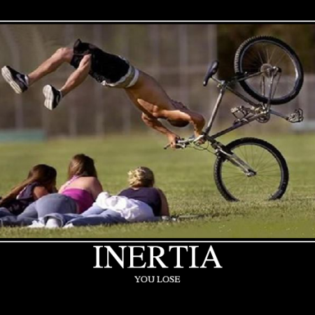
How do balanced and unbalanced forces affect an object?
An unbalanced force that acts on an object changes its speed or direction of motion, or both.
  Newton’s law
    Inertia
      Tendency of objects to
      resist any change in
      motion
      Reason a moving object
      stays in motion with the
      same velocity unless a
      force changes its speed or
      direction or both.

Slide 38
What is inertia?
Inertia is the resistance of any physical object to any change in its state of motion, including changes to its speed and direction.
Inertia tells us the we need a force to get an object to move or stop an object from moving.

Slide 39
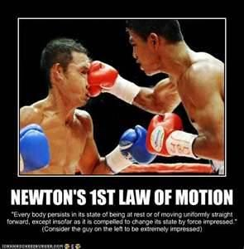
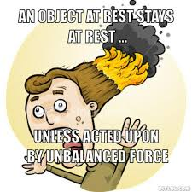
How do balanced and unbalanced forces affect an object?
An unbalanced force that acts on an object changes its speed or direction of motion, or both.
  Newton’s law
    An object will not start moving until a force acts upon it
    An object will stay in motion forever unless an unbalanced force acts upon it

Slide 40
How do balanced and unbalanced forces affect an object?
An unbalanced force that acts on an object changes its speed or direction of motion, or both.
  Change in motion (direction or speed) of an object is
    Proportional to the applied force
    Inversely proportional to the mass.
F = ma
Speed Up? = Need More Force
Gain More mass?
= go slower

Slide 41
How do balanced and unbalanced forces affect an object?
An unbalanced force that acts on an object changes its speed or direction of motion, or both.
  Change in motion (direction or speed) of an object is
    Proportional to the applied force
    Inversely proportional to the mass.
F = ma
Add more Force to Go Faster
Larger objects are harder to move

Slide 42
Exploring Forces
We will look at three examples of forces:
Friction
Gravity
Magnets

Slide 43
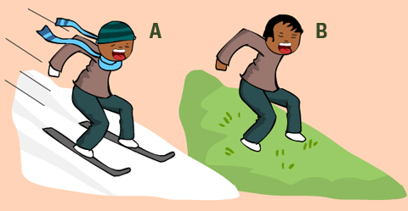
How do balanced and unbalanced forces affect an object?
An unbalanced force that acts on an object changes its speed or direction of motion, or both.
  Friction
    Force that opposes motion
    Between two surfaces that are in contact
    Amount depends on factors
      Roughness of the surfaces
      Force pushing the surfaces together

Slide 44
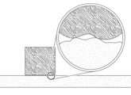
Friction
•Friction is the force that opposes the motion between two surfaces that touch.
•The surface of any object is rough.
•Even an object that feels smooth is covered with tiny hills and valleys.
•The contact between the hills of valleys of two surfaces causes them to stick, resulting in friction.

Slide 45
Friction
•The amount of friction depends on:
–Roughness of the surfaces
–Force pushing the surfaces together

Slide 46
Types of Friction
Kinetic friction occurs when force is applied to an object and the object moves.
Examples:
Sliding Friction: pushing an object across a surface
Rolling Friction: between wheels and a surface
Fluid Friction: opposes the motion of objects traveling through a fluid (air or water)

Slide 47
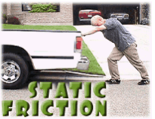
Types of Friction
Static friction occurs when force applied to an object does not cause the object to move.

Slide 48
Reducing Friction
•To reduce the amount of friction, apply a lubricant between two surfaces.
Ex) Motor oil, wax, and grease
•Friction can also be reduced by rolling, rather than pushing, an object.
Notes:
Before you show ways to reduce friction, ask students to talk to a partner and brainstorm ways to reduce friction. If you have your desks in groups, you can say turn to your shoulder partner or talk to your face partner!

Slide 49
Increasing Friction
Friction increases
  when the surface area of an object increases.
  as surfaces are made rougher.
  when the force between two objects increases.
Notes:
Before you show ways to increase friction, ask students to talk to a different partner and brainstorm ways to increase friction.

Slide 50
Gravity
Gravity is the force of attraction between matter.
Gravity depends on:
mass and distance
Notes:
Before starting the section on gravity, play the Brainpop video on gravity.

Slide 51
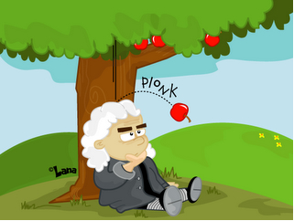
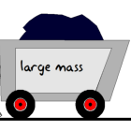
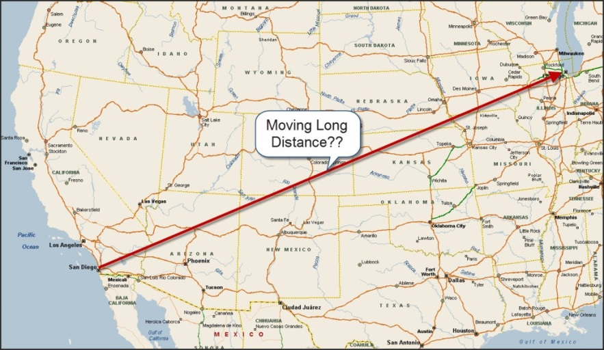
How do balanced and unbalanced forces affect an object?
An unbalanced force that acts on an object changes its speed or direction of motion, or both.
  Newton’s law
    Describes the relationship between
      Gravitational force
      Mass
      Distance

Slide 52
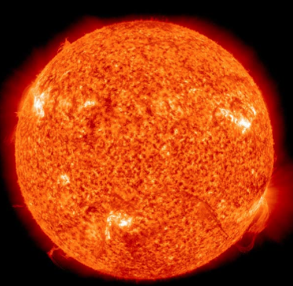
Mass and Gravity
The more massive an object the more it can attract objects to itself.
For example, the Sun has a larger gravitational effect than the Earth.

Slide 53
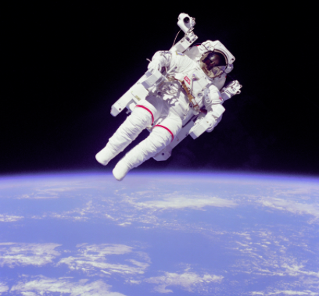
Distance and Gravity
The further away objects get from one another, the less gravitational attraction can be found.
https://www.brainpop.com/science/motionsforcesandtime/gravity/
(2:43)

Slide 54
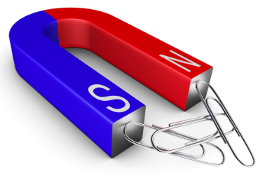
Magnets
A magnet is an object with a north and south pole that produces a magnetic field and exerts a magnetic force.
Notes:
Before beginning magnets, play the Brainpop video on magnetism.

Slide 55
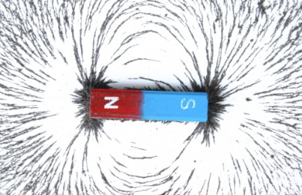
Magnets
A magnetic field is the force field that surrounds the magnet.
A magnetic force can cause objects to attract or repel without needing to touch the magnet!

Slide 56
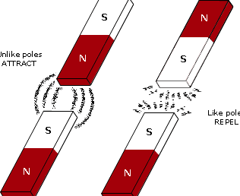
Poles
Like poles will repel or move away from one another.
Opposite poles will attract or move towards one another.
https://www.brainpop.com/science/motionsforcesandtime/magnetism/

Slide 57

Compass
A compass uses the Earth’s magnetic field and magnets to help a person determine direction. The magnet’s poles will line up with the Earth’s north magnetic pole and south magnetic pole.

