Slide 1
Science Thoughts 10/30
In which layer of the atmosphere do humans live?
Troposphere

Slide 2
Today in class
Finish Ozone Reading
introduce
Lab: The Air We Breathe

Slide 3
Science Thoughts 10/31
In which two layers of the atmosphere does the temperature rise as you increase elevation and in which two layers does the temperature fall as you rise in elevation?
Rises – stratosphere, thermosphere
Falls – troposphere, mesosphere

Slide 4
Today in class
Lab: The Air We Breathe

Slide 5
Science Thoughts 11/1
How do the OZONE layer and GREENHOUSE GASES in the atmosphere help to allow life on Earth?
OZONE blocks Ultraviolet Radiation
GREENHOUSE GASES keep in Infrared Radiation

Slide 6
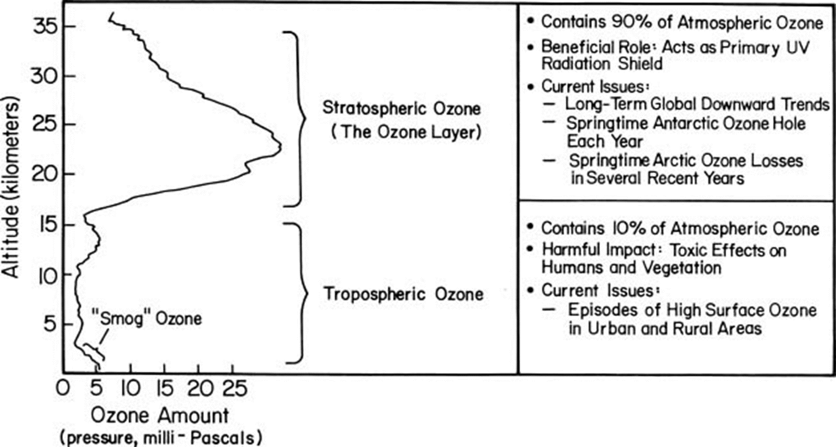

Slide 7
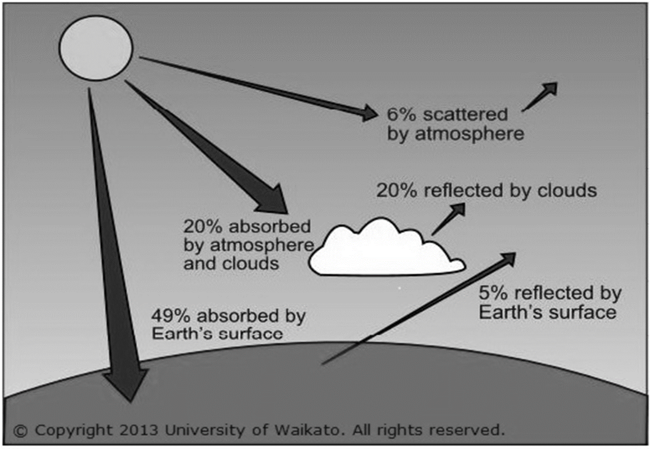

Slide 8
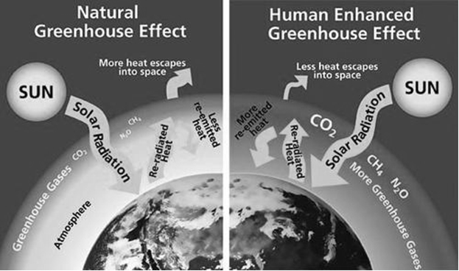

Slide 9
Graphing Greenhouse Gases
https://www.esrl.noaa.gov/gmd/ccgg/trends/

Slide 10
Science Thoughts 11/2
What pattern was seen in the temperatures and greenhouse gases over time graph?
There was a direct correlation – when one rose, the other did also.

Slide 11
Today in class
Graphing Greenhouse Gases
Air Quality WebQuest

Slide 12
Science Thoughts 11/3
Why did the greenhouse gases levels change before humans were on Earth?
Natural events such as volcanos, forest fires and dust storms.

Slide 13
Today in class
https://www.brainpop.com/science/earthsystem/greenhouseeffect/ 3:48
https://www.brainpop.com/science/ourfragileenvironment/airpollution/ 3:31
Test
Grade Lab
Air Quality WebQuest

