Slide 1
June 11 – June 15

Slide 2
Monday in class
Practice NCFE

Slide 3
Tuesday in class
Physics Review

Slide 4
What is “motion”?
A change in position over time.

Slide 5
Review of Motion
Motion is the change of position over time.
Position is the location or place of an object
Reference Point is a location to which you compare other locations
Point of View is where the viewer is located

Slide 6
Imagine that you are seated on a train moving 75 mph.
Explain how you can be moving and not moving at the same time.
Moving if viewed from the street.
Not moving if viewed from the train.

Slide 7
What is speed?
Speed is the distance moved in a given period of time.

Slide 8
What two measurements are needed to calculate speed?
Distance and time

Slide 9
What is the equation for speed?
S=d/t

Slide 10
What is the speed of a runner on a track who runs 800 meters in 2 minutes?
S=D/T
S=800m/2min
S=400m/min

Slide 11
Distance Time Graph

Slide 12
Velocity Time Graph - ACCELERATION

Slide 13
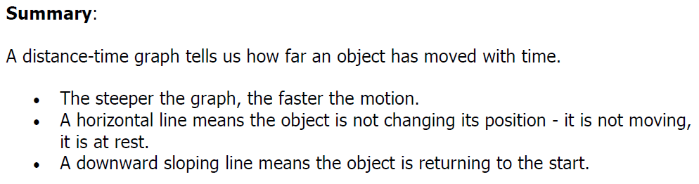
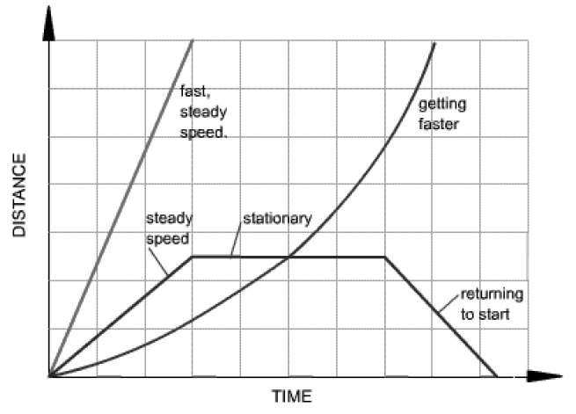
Graphing Changes in Motion

Slide 14
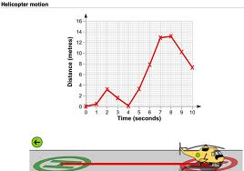
Helicopter Motion
What does this graph tell us about the motion of the helicopter? (list 3)
  Did not travel at a constant speed
  Faster between 4-7 seconds
  Went backwards between 2-4 seconds.

Slide 15
What is the difference between speed and velocity?
Speed is distance over time
Velocity is speed in a direction

Slide 16
How can an object be accelerating if the speed is not changing?
Acceleration is change in VELOCITY so the DIRECTION is changing.

Slide 17
What causes acceleration?
A force applied to an object.

Slide 18
What is a force?
•In science, a force is a push or a pull.
•All forces have two properties:
Direction and Size (use VECTOR)
•A newton (N) is the unit that describes the size of a force.

Slide 19
What is inertia?
An object’s resistance to change of motion

Slide 20
Newton’s Laws
First
inertia – oppose change
(not moving – stay not moving, moving – stay moving)
Second
force = mass * acceleration
(Proportional and inversely proportional)
Third
equal and opposite force
(for every action there is an opposite and equal reaction)

Slide 21

Newton’s Laws of Motion
First Law
Ex: The soccer ball will remain still until kicked by the player (unbalanced force).
“Objects at rest remain at rest, and objects in motion remain in motion, unless acted upon by an unbalanced force.”

Slide 22


Newton’s Laws of Motion
“With increased force, a mass’ acceleration will increase. With increased mass, more force is needed to accelerate.”
Second Law
F=ma
Ex: Using the same force, the lighter box will accelerate faster and move further than the heavier box.
force
acceleration
force
acceleration

Slide 23

Newton’s Laws of Motion
Third Law
Ex: When you run, each foot puts force on the ground, in response, the ground pushes back with an equal and opposite force sending you forward.
“Every time an object exerts a force on another object, the second objects exerts an force equal in size and opposite in direction back on the first object.”

Slide 24
Newton’s Laws of Motion
Forces work in pairs.
Use vectors to represent EQUAL and OPPOSITE forces.
Third Law
(Continued)
Action / Reaction Forces
Action Force
Reaction Force

Slide 25
What is net force?
Combining all the forces acting on a object.
(add same direction, subtract opposite direction)

Slide 26
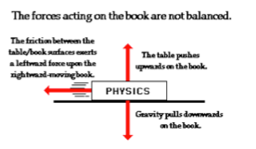
Unbalanced Forces
•When the net force on an object is not 0 N, the forces on the object are unbalanced.
•Unbalanced forces produce a change in motion of an object.

Slide 27
What happens when there are unbalanced forces acting on an object?
The object moves

Slide 28
What causes friction?
Contact between surfaces – the rougher the surface – the more friction.

Slide 29
What is a magnet?
A magnet is an object with a north and south pole that produces a magnetic field and exerts a magnetic force.

Slide 30
Gravity
Gravity is the force of attraction between matter.
Gravity depends on:
mass and distance
Notes:
Before starting the section on gravity, play the Brainpop video on gravity.

Slide 31
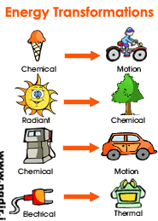
Energy Transformation
The Law of Conservation of Energy states that energy cannot be created nor destroyed. Instead, it must be transformed into another type of energy.
https://www.brainpop.com/science/energy/formsofenergy/
1:52

Slide 32
Mechanical Energy
Mechanical energy is the energy that an object has because of its motion or position.
Mechanical energy is either kinetic or potential.

Slide 33
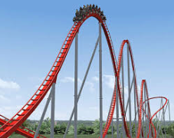
Potential Energy https://www.brainpop.com/science/energy/potentialenergy/
2:06
Stored energy
It is the energy that an object has because of its position or condition.
It can be changed to kinetic energy.

Slide 34
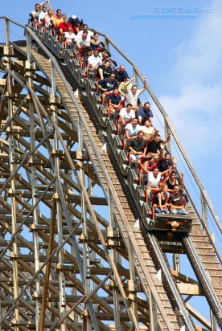
Kinetic Energy https://www.brainpop.com/science/energy/kineticenergy/
2:28
The energy an object has because of its motion.
The amount of kinetic energy an object has is influenced by its mass and speed.

Slide 35
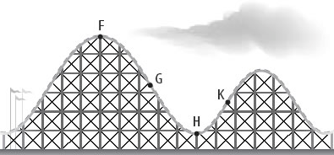
Label the coaster! (8 minute video) https://app.discoveryeducation.com/learn/videos/C574499A-2138-4CF3-A201-0A4EBEB730E5?hasLocalHost=false
Notes:
F- potential energy
G- half potential and half kinetic
H- all kinetic
K- half potential and half kinetic

Slide 36
What is WORK?
When an object is pushed or pulled over a distance.

Slide 37
How does a simple machine make work easier?
Reduces the amount of force needed to do the same work.

Slide 38
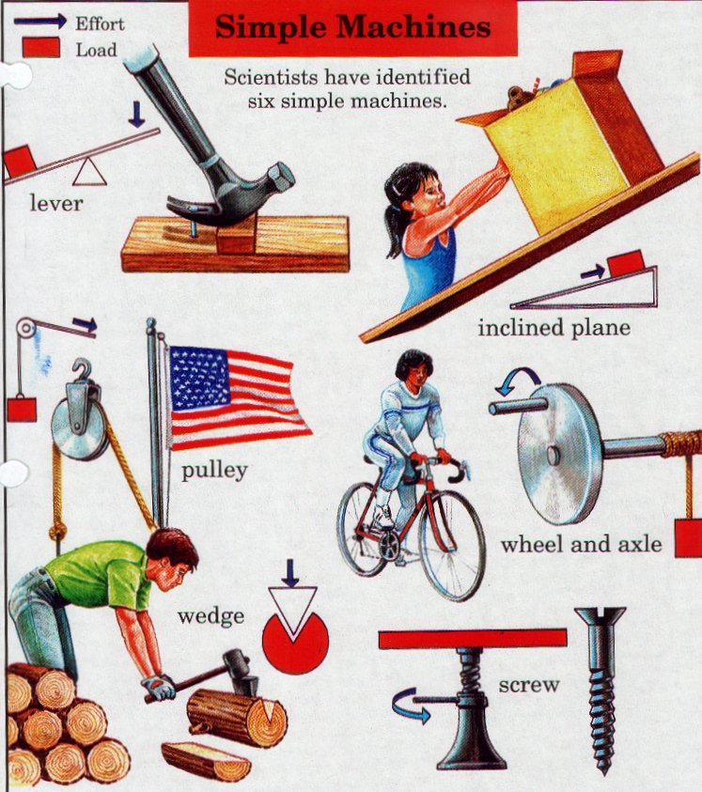
What is a Simple Machine?
A simple machine has few or no moving parts.
Simple machines make work easier

Slide 39
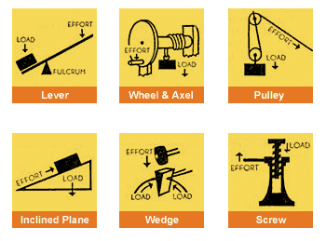
    kinetic and potential energy is involved in the operation of simple machines

Slide 40
How do machines make work easier?
They can change the amount of force
They can change the distance
(Remember that Work = Force X Distance)
They can also change the direction

Slide 41
What is mechanical advantage?
The number of times a machine multiplies the effort or input force.

Slide 42
What is a compound (or complex) machine?
A machine made up of two or more simple machines.

Slide 43
What is energy?
The ability to do work. (in physics – work is movement)

Slide 44
Why is electricity in a circuit a force?
Electrons are being pushed and/or pulled through a circuit.

Slide 45
What is the difference between a series circuit and a parallel circuit?
A series circuit has 2 or more loads on the same “loop” while a parallel circuit has a separate loop for each load.

Slide 46
What is needed for electricity to be useful in our homes and for our appliances and devices?
A Circuit

Slide 47
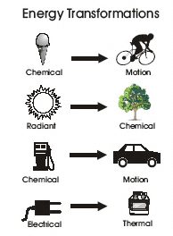
Energy Transformation
The Law of Conservation of Energy
states that energy cannot be
created or destroyed in a system.
Instead, it must be converted, or
transformed, into another type of
energy.
Energy transformation is when
energy is changed from one form
to another.

Slide 48
What is green energy?
Energy that does not harm the environment.

Slide 49
Wednesday in class
Stations
Physical
Earth
Life
Online practice

Slide 50
Thursday in class
Stations
Physical
Earth
Life
Online practice

Slide 51
Friday in class
Stations
Physical
Earth
Life

