Slide 1
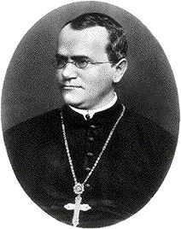
Mendel’s Work

Slide 2
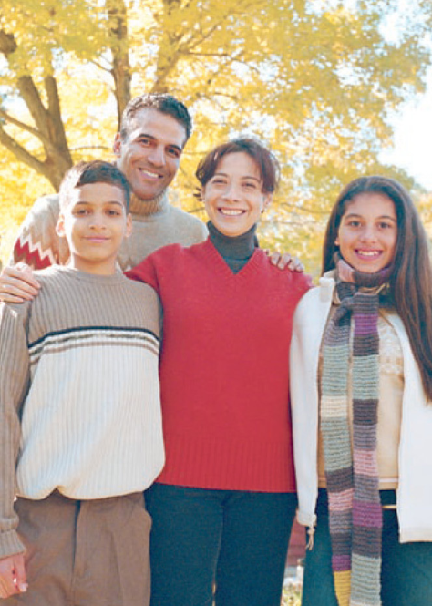
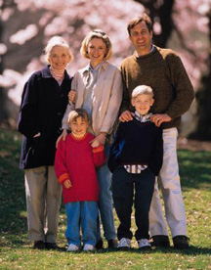
Genetics: The scientific study of heredity.
Heredity: The passing of physical characteristics from parents to offspring.
Traits: the different forms of a characteristic
Ex.) eye color: blue, brown, green
Ex.) height: short, medium, tall

Slide 3
Traits can be passed from generation to generation through 2 primary methods ….
Asexual reproduction
Sexual reproduction

Slide 4
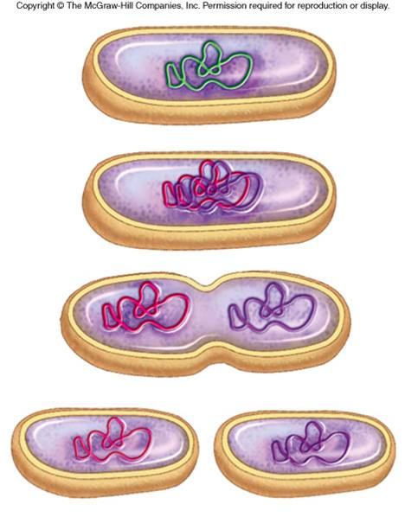
Asexual reproduction is the process by which an organism create a genetic duplicate of itself; only one parent is needed.
Bacteria divide asexually via binary fission.
Binary fission is the subdivision of a cell into two separate cells.

Slide 5
Binary fission is the subdivision of a cell into two separate cells.

Slide 6
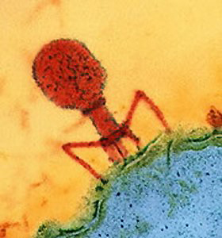
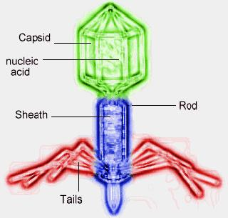
Viruses take control of host cells to produce more viruses.

Slide 7
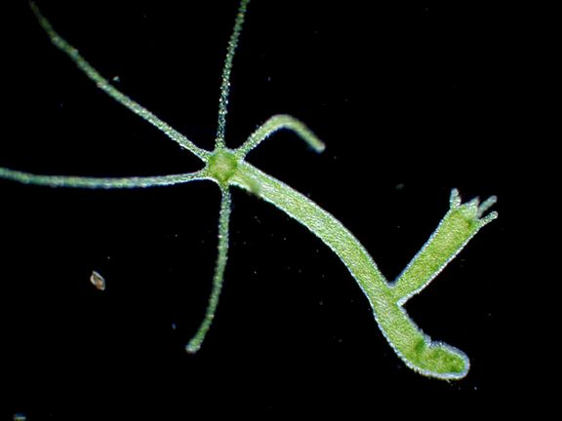
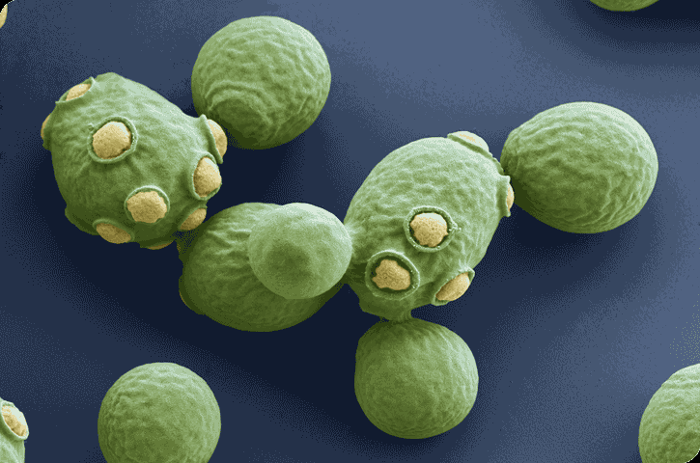
Hydras and yeasts are able to reproduce by budding.
Budding is a form of asexual reproduction in which a new organism grows on another one.
The new organism remains attached as it grows, separating from the parent organism only when it is mature.
Since the reproduction is asexual, the newly created organism is a clone and is genetically identical to the parent organism.

Slide 8
Budding is a form of asexual reproduction in which a new organism grows on another one.

Slide 9
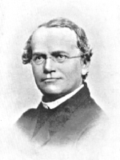
Gregor Mendel
Austrian priest/monk
born July 22, 1822; died January 6, 1884
Known as “The Father of Genetics”
In his job as the monastery gardener, Mendel worked extensively with pea plants to determine how traits are passed from generation to generation.

Slide 10
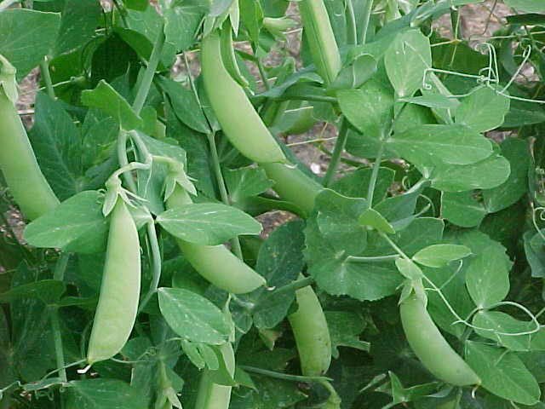
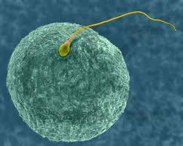
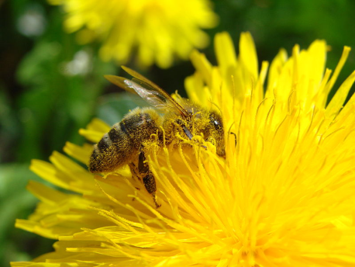
Mendel’s experiments
Mendel fertilized pea plants by cross-pollinating the flowers of purebred pea plants.
Fertilization: the process by which the egg & sperm cell of an organism combine to form a new organism.

Slide 11
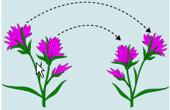
Mendel’s experiments
Mendel fertilized pea plants by cross-pollinating the flowers of purebred pea plants.
Pollination: the transfer of pollen from the pistil of a flower to the stamen of another flower.
Pistil: plant structure that produces the female gamete or sex cell (egg) of a flower
Stamen: plant structure that produces the male gamete or sex cell (sperm) of a flower

Slide 12
Mendel’s experiments
Mendel fertilized pea plants by cross-pollinating the flowers of purebred pea plants.
Purebred: the offspring of many generations with the same traits.
Ex.) Short parents always produce short offspring.
Ex.) Blue-eyed parents always produced blue-eyed offspring.

Slide 13
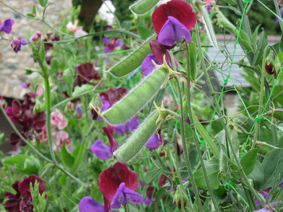
Mendel removed the pollen-producing structures from a pink flower and then brushed the pollen from a white flower onto the pink flower.
These initial plants, or parent plants, are called the P generation.
The plants that are produced from the seeds of the P generation are called the 1st filial or F₁ generation. (Children)
Filial comes from the latin words for son “filius” and daughter “filia.”
The plants that are produced from the seeds of the F₁ generation are called the 2nd filial or F₂ generation. (Grand-children)

Slide 14
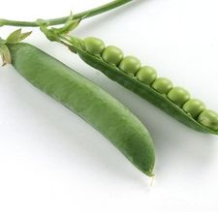
Mendel observed that only 1 form of the trait was present in the F₁ generation.
Ex.) Yellow plants (P generation) crossed with green plants (P generation) always produced yellow plants (F₁ generation).
Mendel further observed that in the F₂ generation, ¾ of the plants showed 1 form of the trait while ¼ showed the other “missing” form of the trait.
Ex.) Yellow plants (F₁ generation) crossed with Yellow plants (F₁ generation) produced Yellow plants ¾ of the time & green plants ¼ of the time.
The same results held true for all purebred traits.
Ex.) Seed shape, stem height, pod shape, pod color, seed coat color.

Slide 15
Mendel’s breeding experiments
Ex.) Seed color
Parents (P)
First generation (F₁)
Female sex cells
from a purebred yellow-seeded plant
Male sex cells in pollen from a purebred green-seeded plant
Cross fertilized (crossed)
All seeds produced turned out yellow
© 2007 Paul Billiet ODWS

Slide 16
Mendel’s breeding experiments
Ex. Continued.) Seed color
1st generation(F₁)
2nd generation (F₂)
Female sex cells
from a yellow-seeded plant
Male sex cells in pollen from a yellow-seeded plant
Cross fertilized (crossed)
3/4 yellow
¼ green
© 2007 Paul Billiet ODWS

Slide 17
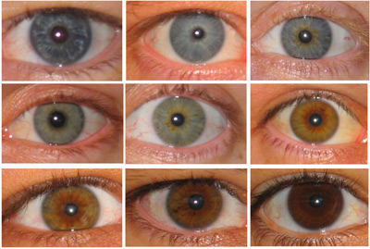
Mendel concluded
Mendel believed that individual factors or sets of genetic “information” must control the inheritance of traits.
The factors that control traits exists in pairs.
Each parent (mother & father) contributes 1 of the factors.
One factor in the pair can mask or hide the other factor.
Gene: the factors that control a particular trait.
Ex.) eye color, height, hair color, nose shape, etc.
Allele: the different forms of a gene
Ex.) eye color: brown, blue, green

Slide 18
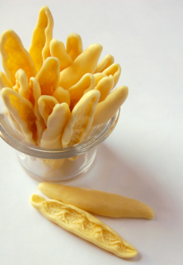
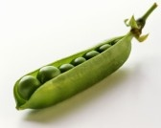
Dominant allele
The form of the gene that will always show up in an organism if present and working correctly.
Typically represented by the 1st capital letter of the dominant allele for a trait.
Ex.) Seed shape: round (R)
Ex.) Seed color: yellow (Y)
Recessive allele
The form of the gene that will only show up if the dominant allele is not present or working correctly.
Typically represented by the lower case letter of the dominant allele for a trait.
Ex.) Seed shape: wrinkled (r)
Ex.) Seed color: green (y)

Slide 19
Dominance versus Prevalence
Just because a particular trait is dominant, meaning the trait will show up if the gene is present & working properly, does not mean it is more prevalent.
Prevalent: majority; happens, takes place or is found most often.
Ex.) Seed color: Yellow is dominant; Green is prevalent
Ex.) Widow’s peak: Having one is dominant; Not having one is prevalent
This is good because there are some genetic diseases that are found on a dominant gene but they are less prevalent in society.

Slide 20
Hybrid
An organism that has 2 different alleles for a particular trait
Ex.) Seed shape: Rr
Ex.) Seed color: Yy
Ex.) Pod shape: Ss
Ex.) Stem height: Tt
The opposite of a purebred organism that has 2 of the same alleles for a particular trait.
Ex.) Seed shape: RR or rr
Ex.) Seed color: YY or yy
Ex.) Pod shape: SS or ss
Ex.) Stem height: TT or tt

Slide 21
Next Steps:
Glue your Sexual/Asexual Reproduction Reading to page 64.
Read the passage and complete the following:
5 annotations (opinion, summary, questions, etc)
A 6 word summary at the end of the reading
Complete the questions
Get the organism pictures and cut out. Glue them into three categories on the processing page:
Sexual | Both | Asexual
5 pictures | 3 pictures | 4 pictures

