Slide 1
Science Thoughts 3/13
What is the difference between dominant and recessive genes?
Dominant are shown if they are present, recessive only show if dominant are not present.

Slide 2
Monday in class
Graphing traits
Conclusions
PowerPoint – Mitosis/Meiosis

Slide 3
Science Thoughts 3/14
How many cells are produced in Mitosis? How many in Meiosis?
miTosis – TWO
mEIOsIs - FOUR

Slide 4
Tuesday in class
PowerPoint – Mitosis/Meiosis
Punnett Squares Powerpoint

Slide 5
Asexual Reproduction
offspring come from a single organism, and inherit the genes of that parent only.
The offspring will be a exact genetic copy of the parent.
Sexual Reproduction
a single specialized cell from a female merges with a specialized cell from a male.
half of the genes come from each parent.
Ex. Humans and other mammals

Slide 6
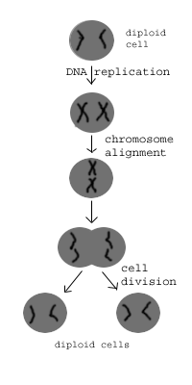
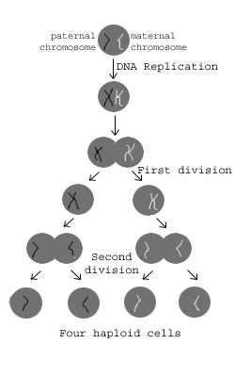
Mitosis: One cell, it makes copies of its chromosomes, then it divides and creates two new identical cells. Asexual reproduction
Meiosis: One cell, it copies its chromosomes and combines them, then it divides, then it combines again, then it divides again into 4 new cells that are half of the first cell, this is for sexual reproduction.

Slide 7
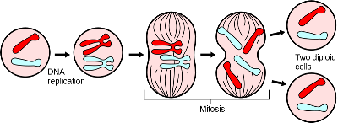
Mitosis and Meiosis
https://www.youtube.com/watch?v=gwcwSZIfKlM
Mitosis
Mitosis is a type of asexual reproduction is when a nucleus undergoes cell division in which two daughter cells are formed, each containing a complete set of chromosomes.
Makes 2 identical daughter cells

Slide 8
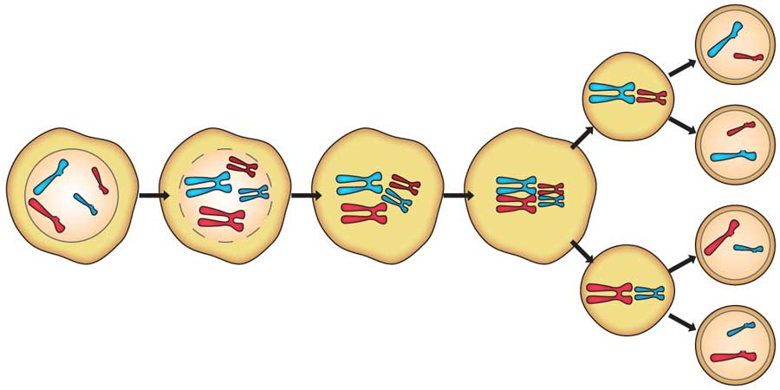
Mitosis and Meiosis
https://www.youtube.com/watch?v=toWK0fIyFlY
Meiosis
Meiosis is a type of sexual reproduction involving a male (sperm cell) and female (egg cell) organism. Meiosis allows for more genetic variation (different genes and physical features).
Makes 4 different daughter cells

Slide 9
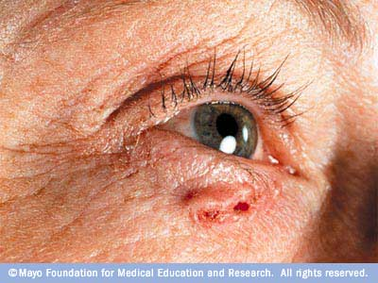
Three reasons why cells reproduce by asexual reproduction: 1. Growth 2. Repair 3. Replacement
Skin cancer - the abnormal growth of skin cells - most often develops on skin exposed to the sun.
Cell that reproduce by asexual reproduction reproduce constantly.

Slide 10
Punnett Square Notes
Fill in your notes as we go. = )

Slide 11
TOOLS TO KNOW
A PUNNET SQUARE IS A TOOL USED TO PREDICT THE POSSIBLE GENOTYPES FOR THE OFFSPRING OF TWO KNOWN PARENTS.
PARENT’S GENES
PARENT’S GENES

Slide 12
TERMS TO KNOW
ALLELES | DIFFERENT FORMS OF A TRAIT THAT A GENE MAY HAVE | T,t
HOMOZYGOUS | AN ORGANISM WITH TWO ALLELES THAT ARE THE SAME | TT, tt
HETEROZYGOUS | AN ORGANISM WITH TWO DIFFERENT ALLELES FOR A TRAIT | Tt, Gg

Slide 13
TERMS TO KNOW
HYBRID | SAME AS HETEROZYGOUS | Tt, Gg
DOMINANT | A TRAIT THAT DOMINATES OR COVERS UP THE OTHER FORM OF THE TRAIT | REPRESENTED BY AN UPPERCASE LETTER T OR G
RECESSIVE | THE TRAIT BEING DOMINATED OR COVERED UP BY THE DOMINATE TRAIT | REPRESENTED BY A LOWER CASE LETTER t or g

Slide 14
TERMS TO KNOW
PHENOTYPE | THE PHYSICAL APPEARANCE OF AN ORGANISM (WHAT IT LOOKS LIKE) | TALL, SHORT, GREEN, WRINKLED
GENOTYPE | THE GENE ORDER OF AN ORGANISM (WHAT ITS GENES LOOK LIKE) | TT, GG, Tt, gg Gg, tt
RATIO | THE RELATIONSHIP IN NUMBERS BETWEEN TWO OR MORE THINGS | 3:1, 2:2, 1:2:1

Slide 15
MONOHYBRID (ONE TRAIT) PUNNETT SQUARE
THE PARENTS’ ALLELES GO ON THE OUTSIDE OF THE SQUARE
B
B
b
b
BB X bb

Slide 16
MONOHYBRID (ONE TRAIT) PUNNETT SQUARE
THE PARENTS’ ALLELES GO ON THE OUTSIDE OF THE SQUARE
DROP THE LETTERS ON THE TOP, INTO EACH SQUARE
B
B
b
B
b
B
b
MOVE EACH LETTER ON THE SIDE, INTO EACH SQUARE
THE ORDER DOES NOT MATTER IN THE BOXES, BUT UPPERCASE FIRST IS A GOOD RULE
b
B
b
B
b

Slide 17
HOW TO USE A MONOHYBRID (ONE TRAIT) PUNNETT SQUARE
WHAT DO THE RESULTS SHOW?
IF B IS THE DOMINANT ALLELE FOR BLACK
RESULTS:
B
B
PHENOTYPIC: 100% BLACK
4:0 RATIO, BLACK TO BROWN
AND b IS THE RECESSIVE ALLELE FOR BROWN
b
Bb
Bb
b
Bb
Bb
GENOTYPIC:
100% Bb
4:0 ALL Bb
THEN WE CAN MAKE PREDICTIONS ABOUT THE OUTCOMES

Slide 18
HOW TO USE A PUNNETT SQUARE
LET’S LOOK AT ANOTHER PUNNETT SQUARE AND PREDICT THE OUTCOME
WHAT ARE THE RESULTS?
T
t
PHENOTYPIC:
75% TALL 25% SHORT
3 TO 1 RATIO:
TALL TO SHORT
T
T
T
T
t
T IS THE DOMINANT ALLELE FOR TALLNESS
t
T
t
t
t
GENOTYPIC:
1TT: 2Tt: 1tt
1:2:1 RATIO
25 %TT, 50% Tt, 25% tt
t IS THE RECESSIVE ALLELE FOR SHORTNESS

Slide 19
Set up the Punnett Square
Write the genotypes of each parent. Put each allele (gene) in it’s own column. Then cross the gametes to determine the possible genotypes of the offspring
Y Y
Parent #1
y
y
Yy
Yy
Parent #2
Yy
Yy

Slide 20
Questions
How many of their offspring will be yellow?
4 out of 4 – 100%
(the dominant trait is stronger than the recessive trait)
How many of their offspring will be green?
0
Are the offspring homozygous or heterozygous?
heterozygous

Slide 21
Example #2: Two plants that are heterozygous for seed color are crossed, what would their offspring look like?
Yy
Yy
X
Parent #1 Parent #2
Y y
Y
y
YY
Yy
Yy
yy

Slide 22
Questions
What percent of the offspring are homozygous dominant?
1 out of 4 – 25%
What percent of the offspring are heterozygous?
2 out of 4 – 50%
What percentage of the offspring are homozygous recessive?
1 out of 4 – 25%
How many of offspring will be yellow?
75%
How many of the offspring will be green?
25%

Slide 23
Science Thoughts 3/15

Slide 24
Wednesday in class
Check Traits Lab – major grade
Determining Genotypes
Sponge Bob Genetics

Slide 25
Science Thoughts 3/16

Slide 26
Thursday in class
Sponge Bob Genetics 2

Slide 27
Science Thoughts 3/17

Slide 28
Friday in class
Notebook check
Punnett Square Worksheet (quiz)
Amoeba Sisters
Mitosis (8:26) https://www.youtube.com/watch?v=f-ldPgEfAHI&feature=youtu.be
Meiosis (7:40) https://www.youtube.com/watch?v=toWK0fIyFlY

