Slide 1
March 20 - 24
Patterns of Heredity
Punnett Squares
Offspring
Ratios
Dominance
co-dominance
incomplete dominance
multiple alleles
sex-linked traits
Pedigrees
QUIZ – Punnett Squares & Pedigrees

Slide 2
Science Thoughts 3/20
What is a pedigree?
Chart that shows traits for multiple generations.

Slide 3
Monday in class
https://www.brainpop.com/science/cellularlifeandgenetics/heredity/ (2:49)
Pedigree Notes

Slide 4
Science Thoughts 3/21
How can you determine genotypes on a Pedigree?
Look at parents and offspring genotypes – follow recessive and dominant rules from Punnett squares.

Slide 5
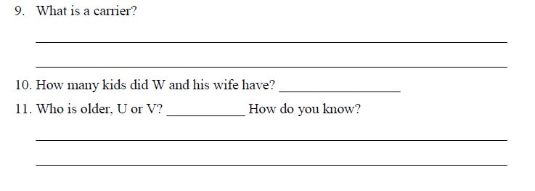

Slide 6
Tuesday in class
Pedigree questions
Pedigree rules
https://www.brainpop.com/science/cellularlifeandgenetics/genetics/ (3:04)
P 102-103 – chromosomes (book)
3-21: Down’s Syndrome – mutations (slides)
Making Pedigrees (copied)
Sex-Linked Genes (copied)

Slide 7
WHY MARCH 21?
the 21st day of the 3rd month, was selected to signify the uniqueness of the triplication (trisomy) of the 21st chromosome which causes Down syndrome.
HISTORY OF WDSD
WDSD was first observed in 2006 in many countries around the world
December 2011: "invites all Member States, relevant organizations of the United Nations system and other international organizations, as well as civil society, including non-governmental organizations and the private sector, to observe World Down Syndrome Day in an appropriate manner, in order to raise public awareness of Down syndrome".

Slide 8
Cell Division – Meiosis and Mitosis

Slide 9
Chromosomes for Down’s Syndrome

Slide 10
Science Thoughts 3/22
On which chromosome is a “sex-linked trait”?
X or Y

Slide 11
Wednesday in class
Finish Sex Linked Chromosomes
Discuss incomplete dominance
vs co-dominance
Incomplete Dominance
review
Kahoot review

Slide 12
Not all alleles are dominant and recessive like the ones Mendel studied in his pea plants.
Some alleles are equally strong and neither are masked by the other.
When both alleles are present, they are both expressed in the phenotype.

Slide 13
Incomplete dominant
both alleles are equally strong
and
the hybrid is a blend of both alleles
When purebred white carnations are crossed with purebred red carnations, the result is a pink carnation.
Incomplete dominant alleles are represented by different capitalized letters.

Slide 14
Codominance
both alleles are equally strong
and
both alleles are visible in the hybrid genotype
When white chickens are crossed with black chickens, the result is not a grey chicken, but a chicken with both black and white feathers.
When expressing incomplete alleles, both alleles are written as superscipt capital letters placed above the letter "i".

Slide 15
Any change in DNA, on purpose or random is called a____?
Mutation

Slide 16
True/False: Some mutations cause no effect.
True

Slide 17
An _____twin is an organism that is genetically identical to the other twin.
Identical

Slide 18
Which tool would you use to show how a particular trait is distributed within a family?
A pedigree

Slide 19
What is a genetic disorder?
A disease or condition that results from mutations

Slide 20
A cancer is a type of genetic mutation that ______?
Results in uncontrolled growth of cells

Slide 21
A half-shaded circle in a pedigree represents a ______.
A female carrier

Slide 22
________ describes a trait that is controlled by genes on the X and Y chromosomes.
Sex linked

Slide 23
People who have one gene for a disease but show no symptoms are called______.
Carriers

Slide 24
____ is a genetic disorder caused by the presence of an extra chromosome or an extra part of a chromosome__.
Down syndrome
21

Slide 25
Which is the best description of offspring produced by asexual reproduction?
Genetically identical to their parent

Slide 26
Which would occur as a result of limited variation in the offspring of asexually reproduced organisms?
Offspring are susceptible to and die from same diseases as their parent

Slide 27
Which describes the cells that are created by the process of mitosis?
Two cells that are genetically identical to the original cell

Slide 28
Which is an accurate description for offspring produced from sexual reproduction?
They receive chromosomes from each parent and have features of both parents

Slide 29
Which will cause an increase in variation of offspring?
Sexual reproduction

Slide 30
During asexual reproduction, how much of the genetic information is passed to the offspring?
All is passed to all offspring

Slide 31
The following diagram shows the dominant trait of brown fur in deer, B.
Family members with two recessive genes will have white fur trait, bb

Slide 32
Provide an accurate prediction for any offspring from Individuals 3 and 4 in generation II.

Slide 33
Science Thoughts 3/23
What happens with a heterozygous cross when the traits have incomplete dominance?
Both displayed
Blend or visible (spots)

Slide 34
Thursday in class
UNIT TEST
Furry Friends –
google classroom or weebly for link

Slide 35
Science Thoughts 3/24
https://www.youtube.com/watch?v=TosVOx7yjts

Slide 36
Friday in class
Notebook check

Slide 37
After Track Out - PROJECT
Impact of environmental and lifestyle choices on biological inheritance.
Genetic Diseases – body system(s) effected
Genetic Disorders – body system(s) effected
Replacing organs with genetically manufactured parts
Students will complete a project to share with the class.
1. Down Syndrome 2. Cystic Fibrosis 3. Hemophilia 4. Achondroplasia 5. Sickle Cell Anemia | 6. Muscular Dystrophy 7. Cri du Chat 8. Marfan Syndrome | 9. Tay-Sachs 10. Huntington’s disease 11. Progeria 12. Spina Bifida

