Slide 1
Reproductive System
The Reproductive System allows the production of offspring
The reproductive system produces specialized cells
the female produces eggs
the male produces sperm
These specialized cells contain genetic material.

Slide 2
The female reproductive system→has two functions:
to produce eggs and
to protect and nourish the offspring until birth

Slide 3
The pituitary gland stimulates eggs in the ovary to grow
An egg is release into the fallopian tube, where it may be fertilized, by a sperm cell
The egg moves to the uterus, where, if fertilized, it implants in the uterine wall

Slide 4
If not fertilized, the egg and the uterine lining exit the body through the vagina in a process called→Menstruation

Slide 5
The male reproductive system→contains the testes, which produce sperm, and the urethra, which is a canal through the penis. Sperm move through the urethra and exit the penis.

Slide 6
The production of offspring include fertilization, pregnancy, and birth
Fertilization→is the joining of one egg cell and one sperm cell
Once fertilized the egg divides, producing an embryo. Cells in the embryo continue dividing
The embryo implants in the spongy lining of the uterus

Slide 7
During the nine months of Pregnancy→the embryo grows and develops, fed through the placenta

Slide 8
Labor and delivery→
The first stage of birth begins with muscular contractions of the uterus
In the second stage, the cervix is fully dilated and the baby leaves the mother
In the third stage, the umbilical cord is cut and the placenta exits the body

Slide 9
Multiple births
single fertilized cell =identical twins
two fertilized eggs =fraternal twins

Slide 10
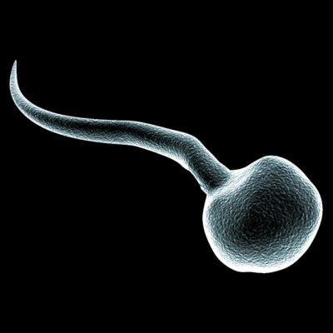
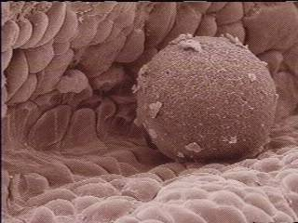
Sperm and Egg

Slide 11
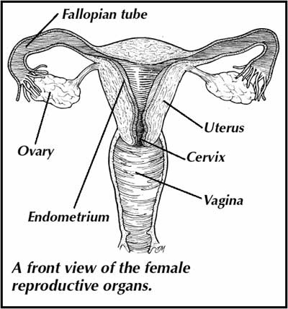
Female Reproductive System

Slide 12
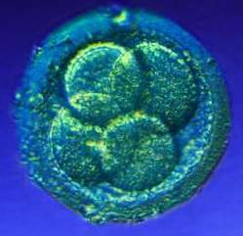
Zygote 1st day until 4th day

Slide 13
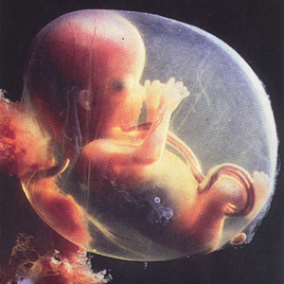
Embryo 4th day until 8th week

Slide 14
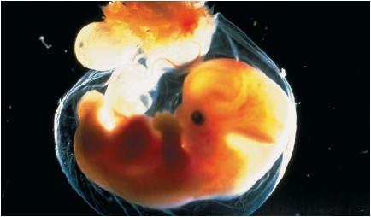
Embryo at 5 weeks

Slide 15
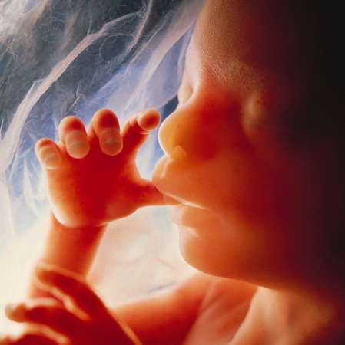
Fetus 9th week until birth

Slide 16
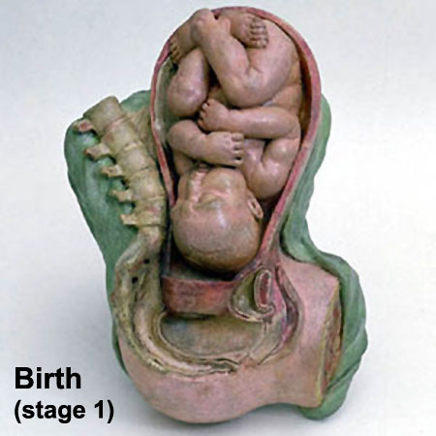
Fetus at Birth

